Slide 1
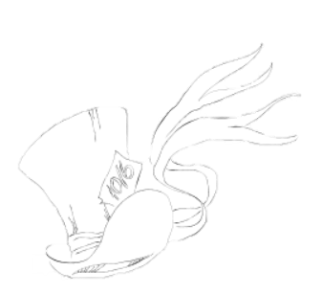





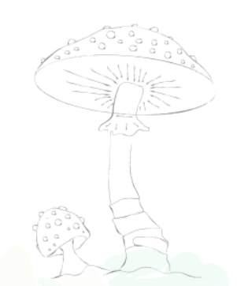
B O U R N E S G R E E N IN F A N T S C H O O L

Slide 2

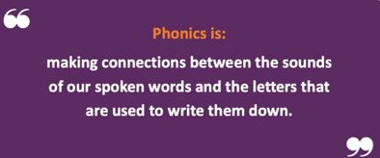
B O U R N E S G R E E N IN F A N T S C H O O L
The journey to independent reading and writing begins with…

Slide 3
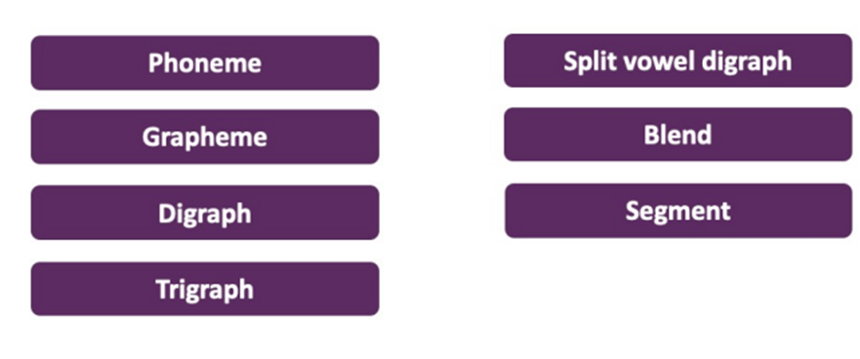
B O U R N E S G R E E N IN F A N T S C H O O L

Slide 4

B O U R N E S G R E E N IN F A N T S C H O O L
How we teach phonics
Our SSP
Planned order
Daily phonics sessions – follow familiar format
e.g. listening for phoneme
sweep to blend
Review/revisit
Teach: Phoneme, GPC, Blend, Read
Practise and Apply
For parents | Letters and Sounds (littlewandlelettersandsounds.org.uk)

Slide 5






B O U R N E S G R E E N IN F A N T S C H O O L
Blending to read
Oral blending first e.g. find me your c-oa –t
Point to to the picture of the c-u-p
Blend the sounds (phonemes) together to read the word.
Spot the digraph first.

Slide 6



B O U R N E S G R E E N IN F A N T S C H O O L

Slide 7
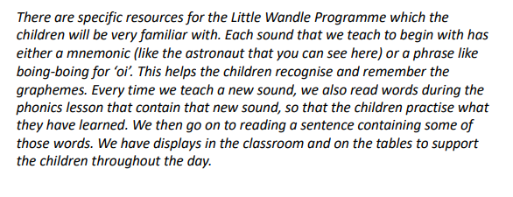
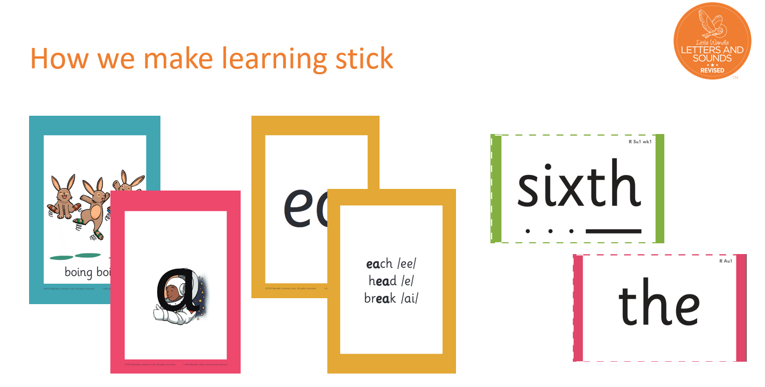

Slide 8

B O U R N E S G R E E N IN F A N T S C H O O L
Tricky Words
Almost all words in the English language can be worked out using the alphabetic code that children learn in school.
It’s made up of 44 sounds and includes sounds like ‘a’ ‘b’ ‘c’ ‘ai’ ‘ee’ ‘igh’ ‘sh’ ‘air’
Many of these sounds can be spelt in a few different ways, but some of the spellings are far more common than others. To get children reading quickly, we teach them the most common way each sound is spelt first.
There are a few with unusual spellings that children need to read and write a lot early on e.g. he said was
‘e’ bed fed shed he was – middle and final letters are tricky
We teach the most common tricky words first which they come across often in their reading. Tip – post it notes! Tricky word detectives!

Slide 9
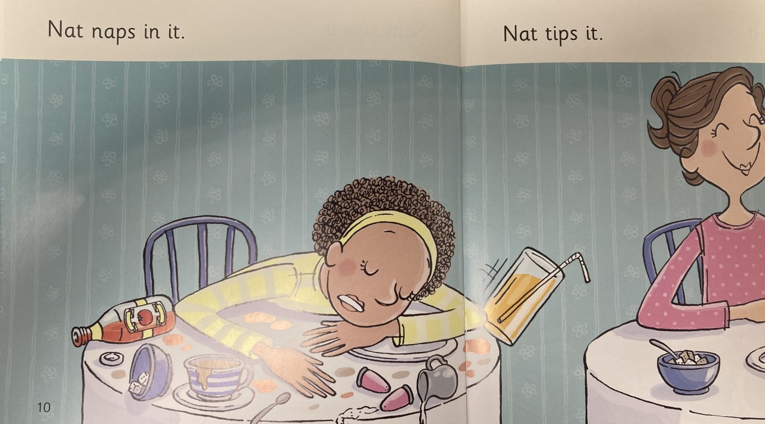
B O U R N E S G R E E N IN F A N T S C H O O L
naps
Take off the s. Blend n –a –p to read nap then add on the s
Oral blending
Point to the c-u-p

Slide 10
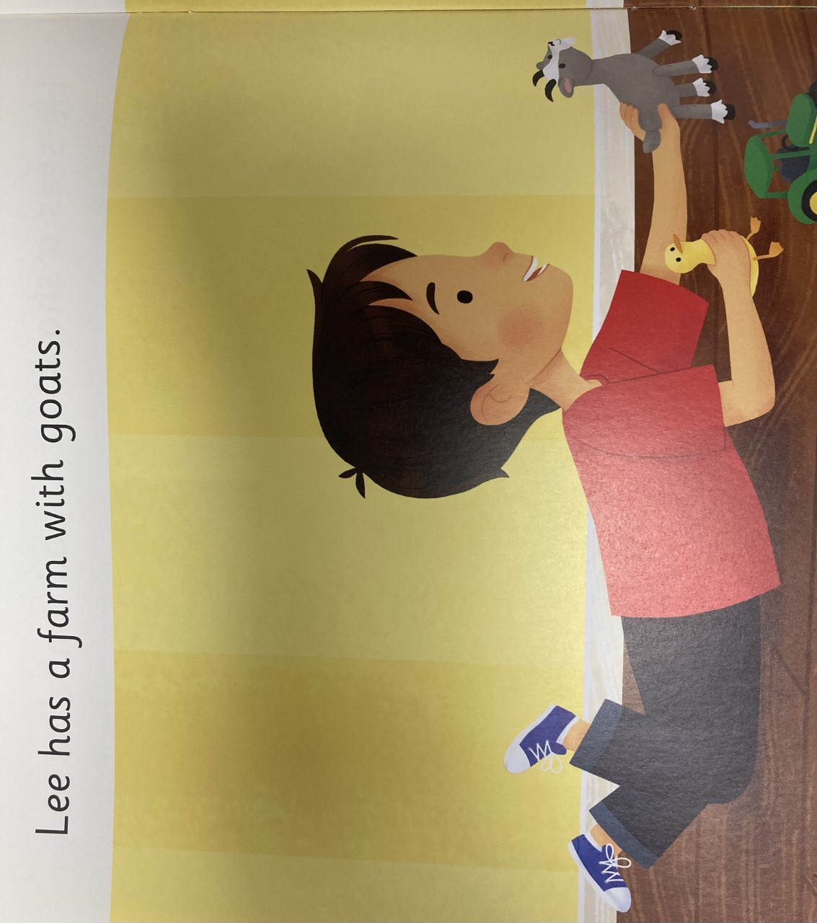
B O U R N E S G R E E N IN F A N T S C H O O L
Spot the digraphs first… ee ar oa
Spot the tricky word ‘has’

Slide 11
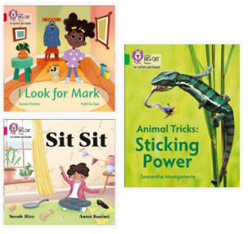
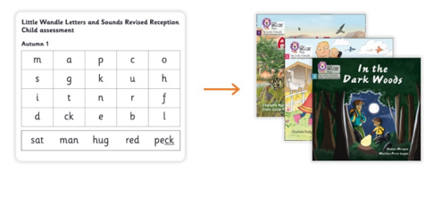
B O U R N E S G R E E N IN F A N T S C H O O L
EYFS and Year 1- Practice reading sessions- x2/3
First session focuses on decoding (sounding out) the words, and the second session we work on prosody which is reading with expression and comprehension. We focus on the same book more than once because we want to develop the fluency. The more children see words, the more they begin to read them automatically without having to sound them out.
Year 2
Daily phonics/spelling sessions
Additional blending practice
Shared reading lessons daily
Storytime

Slide 12
B O U R N E S G R E E N IN F A N T S C H O O L
Once children have a secure knowledge of a number of
GPCs (Grapheme Phoneme Correspondences)
and are confidently blending, they will be ready for
reading books.
This book will come home for a week.
Read every day if you can! We will recognise 3x a week in your child's diary.
Children will bring this decodable book home alongside a sharing
book from the library for you to enjoy together.

Slide 13
B O U R N E S G R E E N IN F A N T S C H O O L
Decodable/Non-decodable | Colour
wordless
Phase 2
Phase 2
Phase 2
Phase 3
Phase 4
Phase 4+
Phase 5
Phase 5
Phase 5+
Non-decodable | Purple
 | Gold
 | White
 | Lime
 | Copper
 | Topaz
 | Ruby

Slide 14
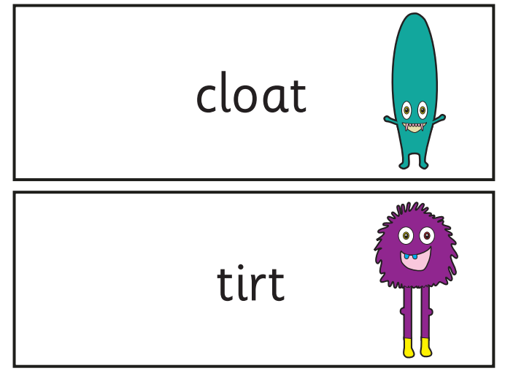
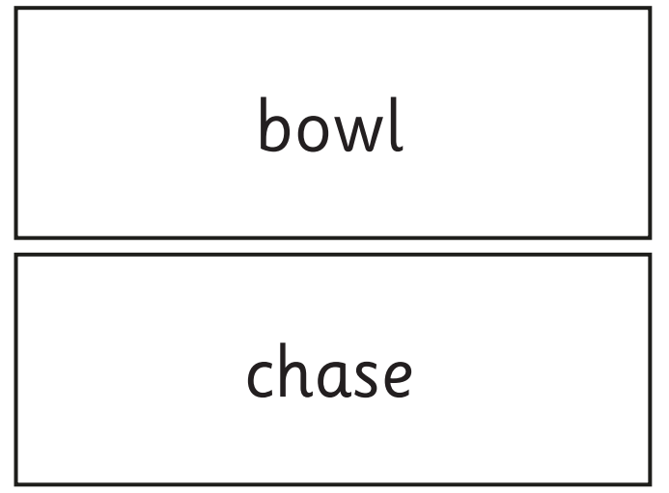
B O U R N E S G R E E N IN F A N T S C H O O L
Phonics Screening Check
National assessment for phonics in June of Year 1
40 words
real words
pseudo/alien words
"achieve the expected standard"
Administered by the class teacher

Slide 15
B O U R N E S G R E E N IN F A N T S C H O O L
Section 1
The words in section 1 will have a variety of simple word structures (for example CVC, VCC, CCVC and CVCC) using:
single letters (a, b, c, d, e, f, g, h, I, j, k, l, m, n, o, p, q(u), r, s, t, u, v, w, x, y, z)
some consonant digraphs (ch, ck, ff, ll, ng, sh, ss, th, zz)
frequent and consistent vowel digraphs (ar, ee, oi, oo,or)
Section 2
The words in section 2 will have a variety of more complex word structures (for example CCVCC, CCCVC, CCCVCC, two syllable words etc) using the grapheme phoneme correspondences (GPCs) from section one as well as the GPCs listed below:
additional consonant digraphs (ph, wh)
less frequent and consistent vowel digraphs, including split digraphs (a-e, ai, au, aw, ay, ea, e-e, er, ew, i-e, ie, ir, oa, o-e, ou, ow, oy, ue, u-e, ur)
trigraphs (air, igh)
alternative pronunciations (a, c, ch, e, ea, er, g, I, ie, o, oo, ou, ow, s, u, ue, u-e)

Slide 16
B O U R N E S G R E E N IN F A N T S C H O O L
Supporting your child with phonics and reading
Regular reading
Flashcards - learn the correct pronunciation!
Words/graphemes around the house
Use our curriculum maps to see what is being taught and when
For the screening check -
All of the above! Keep practising blending and spotting digraphs in words
If your child has some gaps in their GPC knowledge focus on those
If you have any concerns or questions always speak to your child's teacher.
For parents | Letters and Sounds (littlewandlelettersandsounds.org.uk)

Slide 17
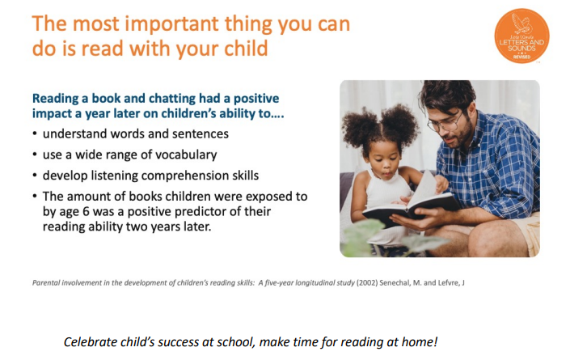
B O U R N E S G R E E N IN F A N T S C H O O L

