Slide 1


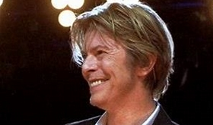
ARTIST OF THE HALF TERM – Autumn 2 2023
David Bowie
David Robert Jones was born on 8th January 1947. He was professionally known as David Bowie and was an English singer, songwriter, musician, and actor. A leading figure in the music industry, he is regarded as one of the most influential musicians of the 20th century.
Bowie was acclaimed by critics and musicians, particularly for his innovative work during the 1970s. His career was marked by reinvention and visual presentation, and his music and stagecraft had a significant impact on popular music. Bowie's popular records included "Space Oddity", "Heroes", "Ashes to Ashes", "Under Pressure" (a 1981 collaboration with Queen) and Let's Dance.
Bowie was also an accomplished actor and starred in a number of films including Merry Christmas, Mr.
Lawrence, Labyrinth, Twin Peaks: Fire Walk with Me and The Prestige.
During his lifetime, his record sales, estimated at over 100 million records worldwide, made him one of the best-selling musicians of all time. In the UK, he was awarded ten platinum, eleven gold
and eight silver album certifications and released 11 number-one albums.
In the US, he received five platinum and nine gold certifications. He was inducted into
the Rock and Roll Hall of Fame in 1996. Rolling Stone ranked him among the greatest
artists in history. As of 2022, Bowie was the best-selling vinyl artist of the 21st century.

Slide 2
B O U R N E S G R E E N S C H O O L S
Parent Partnership Meeting
Thursday 9th November 2023
Welcome!
School Improvement Plans (SIP)
Bournes Green SIP 23/24
AOB

Slide 3
B O U R N E S G R E E N S C H O O L S
School Improvement Plan (SIP)
What is a SIP?
How often do schools write a SIP?
Who writes the SIP?
Who checks the SIP?

Slide 4
B O U R N E S G R E E N S C H O O L S
Bournes Green SIP 23/24
To review and prepare for a relaunch of the Vision & Values of Bournes Green Schools (L&M)

Slide 5
B O U R N E S G R E E N S C H O O L S
Bournes Green SIP 23/24
To accelerate the progress for children with SEND to reduce the attainment gap and improve outcomes. (QofE)

Slide 6
B O U R N E S G R E E N S C H O O L S
Bournes Green SIP 23/24
3. To further develop the quality of Teaching & Learning in every classroom by embedding an enhanced CPD offer. (QofE)

Slide 7
B O U R N E S G R E E N S C H O O L S
Bournes Green SIP 23/24
To ensure our EYFS provision is fully prepared for the new EYFS Policy (EYFS)

Slide 8
B O U R N E S G R E E N S C H O O L S
Bournes Green SIP 23/24
To review and update the trips and residential offers for our children (PD)

Slide 9




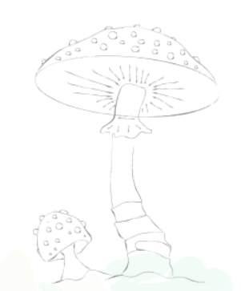
B O U R N E S G R E E N S C H O O L S
Questions

Slide 10
B O U R N E S G R E E N S C H O O L S
AOB

Slide 11
B O U R N E S G R E E N S C H O O L S
Thank you for coming!

Slide 12
ARTIST OF THE HALF TERM – Autumn 2 2023
David Bowie
David Robert Jones was born on 8th January 1947. He was professionally known as David Bowie and was an English singer, songwriter, musician, and actor. A leading figure in the music industry, he is regarded as one of the most influential musicians of the 20th century.
Bowie was acclaimed by critics and musicians, particularly for his innovative work during the 1970s. His career was marked by reinvention and visual presentation, and his music and stagecraft had a significant impact on popular music. Bowie's popular records included "Space Oddity", "Heroes", "Ashes to Ashes", "Under Pressure" (a 1981 collaboration with Queen) and Let's Dance.
Bowie was also an accomplished actor and starred in a number of films including Merry Christmas, Mr.
Lawrence, Labyrinth, Twin Peaks: Fire Walk with Me and The Prestige.
During his lifetime, his record sales, estimated at over 100 million records worldwide, made him one of the best-selling musicians of all time. In the UK, he was awarded ten platinum, eleven gold
and eight silver album certifications and released 11 number-one albums.
In the US, he received five platinum and nine gold certifications. He was inducted into
the Rock and Roll Hall of Fame in 1996. Rolling Stone ranked him among the greatest
artists in history. As of 2022, Bowie was the best-selling vinyl artist of the 21st century.

