Slide 1

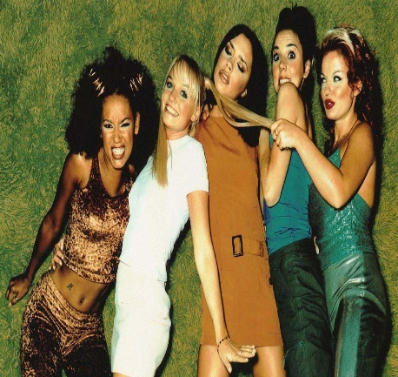

ARTIST OF THE HALF TERM – Summer 2 2024
Spice Girls
.
The Spice Girls were an English pop group formed in 1994. The group consists of Melanie Brown ("Scary Spice"), Melanie Chisholm ("Sporty Spice"), Emma Bunton ("Baby Spice"), Geri Halliwell ("Ginger Spice"), and Victoria Beckham ("Posh Spice").
..
They were signed to Virgin Records and released their debut single “Wannabe” in 1996, which hit number one in 37 countries and established them as a global phenomenon. Their debut album Spice sold more than 31 million copies worldwide, becoming the best-selling album by a female group in history. Their follow up album Spiceworld sold over 20 million copies worldwide. The Spice Girls have sold over 80 million records worldwide, making them the best-selling female group of all time, one of the best-selling pop groups of all time, and the biggest British pop phenomenon since The Beatles.
.
At the peak of their success, their international record sales, tours, merchandising and film, Spice World estimated their revenue to be between $500–800 million between 1996 and 1998 alone.
..
Under the guidance of their mentor and manager Simon Fuller, the Spice
Girls embraced merchandising and became a regular feature of the British
and global press. Many musical journalists believe the Spice Girls as the
most well-known group of individuals since The Beatles.
..
Since splitting up, the girls have gone on to be very successful in different
areas of singing, acting, designing clothes, television and radio broadcasting.

Slide 2
B O U R N E S G R E E N S C H O O L S
Parent Partnership Meeting
Tuesday 9th July 2024
Welcome and Introductions
Mr Denchfield
Mr Stickley
Questions

Slide 3
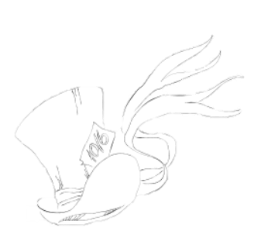



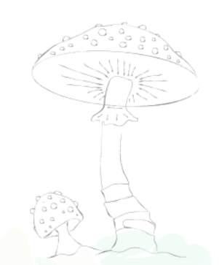
B O U R N E S G R E E N S C H O O L S
Welcome and Introductions

Slide 4
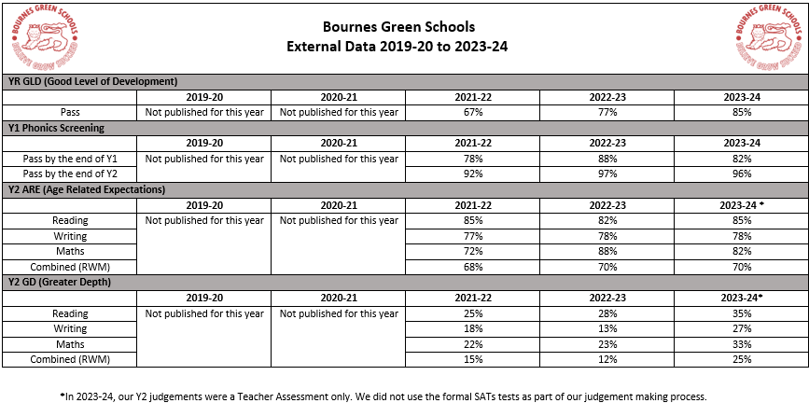
B O U R N E S G R E E N S C H O O L S
Mr Denchfield

Slide 5
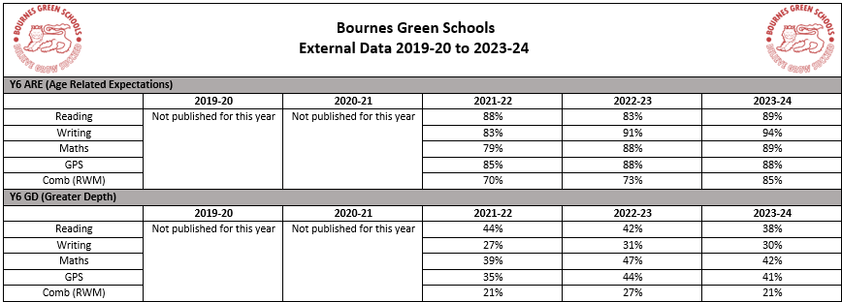
B O U R N E S G R E E N S C H O O L S
Mr Denchfield

Slide 6
B O U R N E S G R E E N S C H O O L S
Mr Denchfield

Slide 7
B O U R N E S G R E E N S C H O O L S
Mr Stickley

Slide 8
B O U R N E S G R E E N S C H O O L S
Questions
Next Steps
AOB

Slide 9
ARTIST OF THE HALF TERM – Summer 2 2024
Spice Girls
.
The Spice Girls were an English pop group formed in 1994. The group consists of Melanie Brown ("Scary Spice"), Melanie Chisholm ("Sporty Spice"), Emma Bunton ("Baby Spice"), Geri Halliwell ("Ginger Spice"), and Victoria Beckham ("Posh Spice").
..
They were signed to Virgin Records and released their debut single “Wannabe” in 1996, which hit number one in 37 countries and established them as a global phenomenon. Their debut album Spice sold more than 31 million copies worldwide, becoming the best-selling album by a female group in history. Their follow up album Spiceworld sold over 20 million copies worldwide. The Spice Girls have sold over 80 million records worldwide, making them the best-selling female group of all time, one of the best-selling pop groups of all time, and the biggest British pop phenomenon since The Beatles.
.
At the peak of their success, their international record sales, tours, merchandising and film, Spice World estimated their revenue to be between $500–800 million between 1996 and 1998 alone.
..
Under the guidance of their mentor and manager Simon Fuller, the Spice
Girls embraced merchandising and became a regular feature of the British
and global press. Many musical journalists believe the Spice Girls as the
most well-known group of individuals since The Beatles.
..
Since splitting up, the girls have gone on to be very successful in different
areas of singing, acting, designing clothes, television and radio broadcasting.

