Slide 1
Parent partnership meeting
Bournes Green Schools
09.07.2024

Slide 2
Under the current project – Delivery
Bournes Green Building Works
Project | Benefit | Cost
Remodelling of every Junior classroom (ceiling, teaching wall, floor, lighting, internal doors, removal of some internal walls, removal of toilets in classrooms, decorating, display boards etc) | High quality classrooms for every child in the Juniors | £ 409,100
 | Classrooms similar to those in the Infants
 | Positive impact on T&L
 | Better learning environments could promote pride in their environment
 | Consistency across the schools
 | Improved organisation
 | Promotes independence of learning through accessible resources
 | 6 larger classrooms. Important as we have 33 children in each class and the lack of space can affect T&L as well as natural access to the Interactive Screens.
Updated heating/cooling units in the Infant classrooms (as per the Junior classrooms) | Improved environment for learning in warmer months | £ 35,000
 | Positive impact on T&L, especially during hotter days
 | Consistency across the schools

Slide 3
New Junior toilets | Current toilets have potential H&S issues | £ 20,000
 | Nicer environment
 | Less disruption to learning
 | More toilets – less waiting and behaviour issues could be reduced
Extended Junior Hall | Whole School Assemblies are an option | £ 45,000
 | Improved indoor PE/clubs offer
 | Increased space for lunch provision
 | Increased capacity for productions/ events
Storage solutions for the Junior school | Urgently need storage in the Junior building. | £ 15,000
 | Most resources/ books are in the cabin and are not storing well
 | Lunchtime storage to allow the hall to maximise its use.
 | More accessible to staff
 | Cabin becomes available for its original purpose; outdoor learning. FYI, it was purchased by the PA.

Slide 4
Part of the Staff Room converted to an Intervention Room | The are no designated rooms for interventions across either schools | £ 5,000
 | Supports SEN/vulnerable children
 | Option to use for additional work (e.g. counselling)
Staff Room relocated to Magnolia Room | Allows for the new toilets and intervention room | £ 2,500
 | Drop Zone have a better relocation option
 | Size is similar to current staff room
Bungalow returns to The Drop Zone and the computer room is converted to a Music Room | Better Drop Zone provision the current room (e.g. greater indoor and outdoor space). | £ 2,000
 | Music in the current rooms is an ongoing issue. The noise disrupts PE lessons/ assemblies etc.
Link corridor to join the schools | Dry and direct route between the schools | £ 27,000
 | Allow shared use of hall space
 | Pupil transit to pool area
Making good of Infant Building |  | £ 1,500
Contingency |  | £ 20,000
 |  | £ 582,100

Slide 5
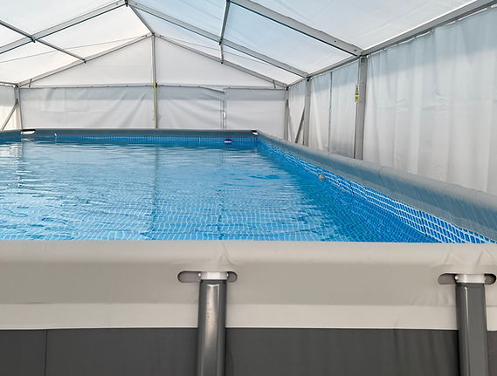

Slide 6
Capital spend 2018 – 2024
Bournes Green Schools £706,395
Hinguar £187,221
Richmond Avenue £377,140
Shoeburyness High School £1,414,976
Thorpedene £771,931
Bournes Green Schools exc link £405,627

Slide 7
Works undertaken at Bournes Green Schools
Building Management System
Tarmac Repairs
Boiler Room Window and Door
Temporary DDA Access Ramp
External Handrails
Dead Legs
Roof Repairs
Asbestos Management Surveys
Roof Repairs
Flooring
Fire Safety Upgrades - Project
Door entry system
IT Equipment
Aircon Install
Power Upgrade
Asbestos removal
Artificial Grass
Machines
Surfacing works
Gates

Slide 8
Academy Vs Maintained capital
If the Bournes Green Schools were still maintained schools (under Local Authority control) the following capital income would have come in in the same period:

Slide 9
Reserves bids 2022-23 for BG Schools
Infants teaching walls £42,700
Soft surfacing for play equipment £8,500

Slide 10
Link extension - £300,768
Concrete £209,500
Sewer works £5,000
Planning fees and inspections £43,500
Steels deposit £30,700
Statutory inspections £4,250
Enabling works £11,500
Under the current plans approx. 80% of the concrete base will be used - Over time the intention is still to deliver the complete elements of the project as funding allows. This will be over a longer timeframe

Slide 11
Original project budget
Capital spend (capital use only) £0
Reserves spend (any use) £1,000,000
Reserves at the end of 2022 £2,900,000
Reserves at the end of 2024 (projected) £1,600,000

Slide 12
What changed
Contribution to schools to offset unfunded pay rises for 2022/23 £225,000
Unfunded pay/pensions uplift for 2023/24
Advised unfunded pay rises for support for 2024/25 and Teachers pay above 2%
Energy costs spiked by over double – we hold fixed price contracts and a number expired in 22/23. These will reduce but by how much is unknown.
Depletion of reserves to support outcomes and invest in our estate

Slide 13
Ofsted

Slide 14
Both Bournes Green Schools were visited in 2023 and both were graded Good in all areas.
From the front page of the BGI report:

Slide 15
This school was last inspected under section 5 of the Education Act 2005 16 years ago and judged ‘Outstanding’ under a previous inspection framework. This reflected the school’s overall effectiveness under the inspection framework in use at the time.
From then until November 2020, the school was exempted by law from routine inspection, so there has been a longer gap than usual between graded inspections under section 5 of the Act. Judgements in this report are based on the current inspection framework and also reflect changes that may have happened at any point since the last graded inspection

Slide 16
Benefits of a Trust
Staff say they are well supported by school and trust leaders. Their workload and well-being are well considered. Communication is a strength. Staff welcome the opportunities to work with other schools. They benefit professionally from the different training courses that are offered.

Slide 17
Area for improvement
The academy committee does not yet fully understand its new roles and responsibilities. Consequently, some of its duties are not being fulfilled effectively. Opportunities to support school leaders are being missed. The trust should ensure that the academy committee understands its roles and responsibilities and carries out its duties effectively. This will enable the committee to provide appropriate support and challenge to school leaders.

Slide 18
Shoeburyness report June 2024
The trust and school work together to raise standards effectively. Trustees know the school well. They challenge and support leaders effectively to improve the quality of provision. Staff value the professional development opportunities that leaders provide and the way that leaders are considerate of their workload and well-being with regard to assessment and meeting expectations.

Slide 19
Reinspection of historic outstanding schools
As Ofsted reviewed in November 2022, of the amount of historic graded Outstanding schools retaining that grade on reinspection was less than 20%. With 17% going on to be graded as Requires Improvement and 4% Inadequate.
That means the remaining approx. 60% were graded as good of the thousands of schools reinspected, as were the Bournes Green schools.

Slide 20
Amanda Spielman (2022)
“Regular inspection gives parents confidence in the quality of their child’s school. Exempting outstanding schools deprived parents of up-to-date information. It also left a lot of schools without the constructive challenge that regular inspection provides.
The exemption was a policy founded on the hope that high standards, once achieved, would never drop, and that freedom from inspection might drive them even higher. These outcomes show that removing a school from scrutiny does not make it better.” Hundreds of formerly outstanding schools reinspected - GOV.UK (www.gov.uk)

Slide 21
Q & A Section

