Slide 1


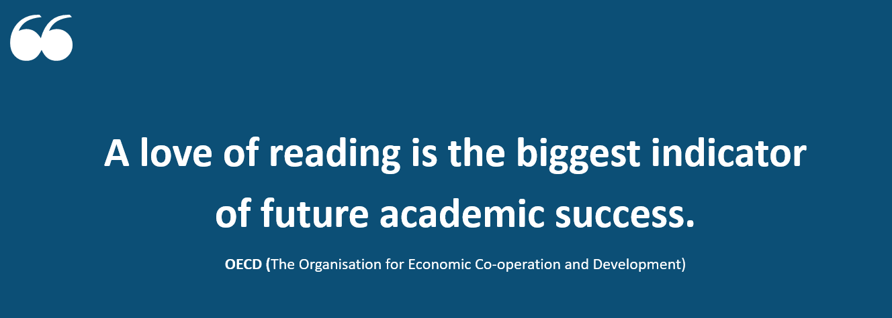
B O U R N E S G R E E N S C H O O L S
.
Believe, Grow, Succeed

Slide 2

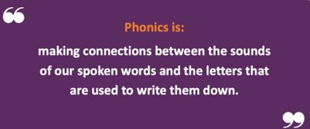
B O U R N E S G R E E N S C H O O L S
.
Believe, Grow, Succeed
The journey to independent reading and writing begins with…

Slide 3
B O U R N E S G R E E N S C H O O L S
.
Believe, Grow, Succeed
Terminology
Grapheme
A letter or group of letters used to represent a particular sound when writing. ‘a sound written down’
Phoneme
one letter that make one sound
Digraph
two letters that make one sound
Trigraph
three letters that make one sound
Blend
putting sounds together to read a word
Segment
breaking apart the sounds in a word

Slide 4

B O U R N E S G R E E N S C H O O L S
.
Believe, Grow, Succeed
How we teach phonics
Daily phonics sessions – follows familiar format
Mon-Thurs is usually a focus lesson such as a new sound
Friday is usually a recap and review of the new information the children have been taught.
Each lesson
- Review/revisit
- Teach- Phoneme, GPC, Blend, Read
- Practise and Apply- reading a sentence, spelling
Our school has chosen ​Little Wandle Letters and Sounds Revised as our Systematic Synthetic Phonics (SSP) programme to teach early reading and spelling.
For parents | Letters and Sounds (littlewandlelettersandsounds.org.uk)

Slide 5






B O U R N E S G R E E N S C H O O L S
.
Believe, Grow, Succeed
Blending to read
Oral blending first e.g. find me your c-oa –t, Point to to the picture of the c-u-p
Blend the sounds (phonemes) together to read the word.
Spot the digraph first.

Slide 6

Blending to read words
B O U R N E S G R E E N S C H O O L S
.
Believe, Grow, Succeed
https://youtu.be/IL5YUCPyC5I
Notes:
Slide purpose:
To provide an overview of blending
Suggested script:
Some children learn to blend really quickly, and others take a little longer.
If your child is finding it difficult, ask your child’s teacher for ways to help at home – playing blending games at home is so helpful!
Show parents the ‘How we teach blending’ video from ‘For parents’ area of the website: https://www.littlewandlelettersandsounds.org.uk/resources/for-parents/

Slide 7

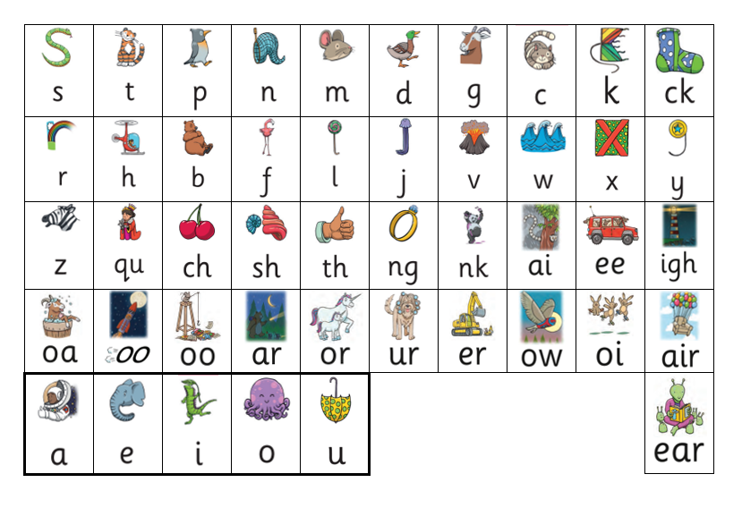
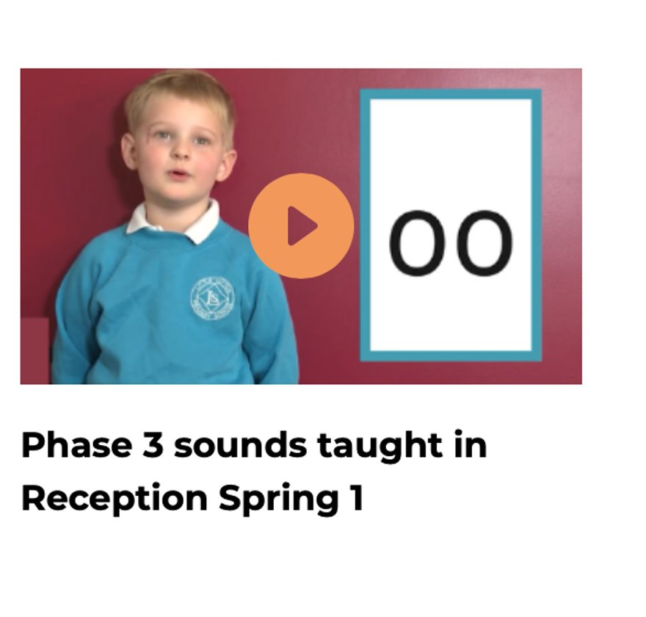
Saying the Phase 2 and 3 sounds
B O U R N E S G R E E N S C H O O L S
.
Believe, Grow, Succeed
For parents | Letters and Sounds (littlewandlelettersandsounds.org.uk)
Notes:
https://www.littlewandlelettersandsounds.org.uk/resources/for-parents/

Slide 8
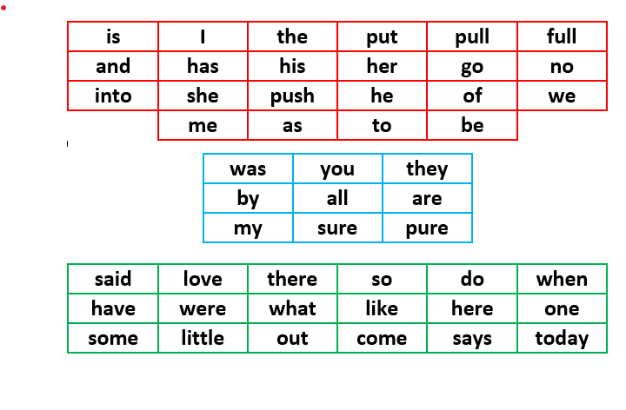
Tricky Words
B O U R N E S G R E E N S C H O O L S
.
Believe, Grow, Succeed
Tip – post it notes! Tricky word detectives! On doors!​
​

Slide 9
B O U R N E S G R E E N S C H O O L S
.
Believe, Grow, Succeed
Spelling

Slide 10

Spelling
B O U R N E S G R E E N S C H O O L S
.
Believe, Grow, Succeed
Your child will be taught how to spell words, using the graphemes they have been taught.
How do we teach spelling?
Say the word.
Segment the sounds.
Count the sounds.
Write them down.
You child will be given a grapheme mat to keep at home. They will need this to write in Reception.
If you need a new one, please let your child’s class teacher know.

Slide 11
How we expect your child to spell in reception using their phonetic knowledge
B O U R N E S G R E E N S C H O O L S
.
Believe, Grow, Succeed
Sit – sit
Shoe- shoo
Mouse- mows
Super- sooper
When writing at home with your child we ask that you also teach them to use the sounds that they know to help them with their independent writing.

Slide 12
B O U R N E S G R E E N S C H O O L S
.
Believe, Grow, Succeed
Reading in School

Slide 13
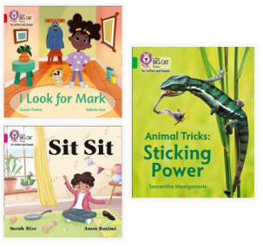
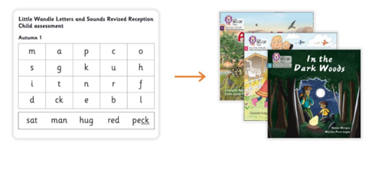
B O U R N E S G R E E N S C H O O L S
.
Believe, Grow, Succeed
EYFS and Year 1- Practice reading sessions- x2
First session focuses on decoding (sounding out) the words, and the second session works on prosody which is reading with expression and comprehension.
We focus on the same book more than once because we want to develop the fluency.
The books your children will be taking home are matched to their phonetic ability. We want children to be able to read fluently and not find reading to be a chore.

Slide 14
B O U R N E S G R E E N S C H O O L S
.
Believe, Grow, Succeed
Reading at Home

Slide 15


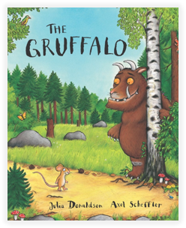
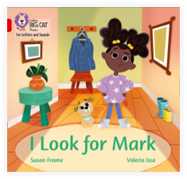
B O U R N E S G R E E N S C H O O L S
.
Believe, Grow, Succeed
Books Going Home

Slide 16
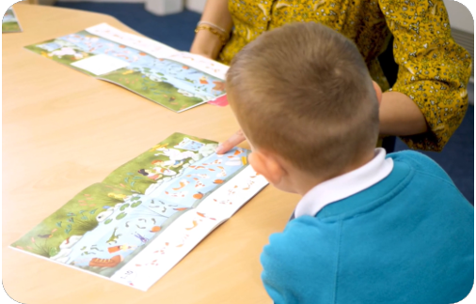
Reading wordless books
B O U R N E S G R E E N S C H O O L S
.
Believe, Grow, Succeed
Wordless books are invaluable as they teach reading behaviours and early reading skills to children who are not blending – yet!
Talk about the pictures.
Oral blend spotting.
Point to the images in the circles and find them on the page.
Encourage your child to make links from the book to their experiences.

Slide 17
Listening to your child read their phonics book
B O U R N E S G R E E N S C H O O L S
.
Believe, Grow, Succeed
Your child should be able to read their book without your help.
They might sound out words and blend them before they read them fluently.
If they can’t read a word, sound the word out and read it to them. Then ask them to repeat it.
Talk about the book and celebrate their success.

Slide 18

Read to your child
B O U R N E S G R E E N S C H O O L S
.
Believe, Grow, Succeed
The shared book is for YOU to read:
Make the story sound as exciting as you can by changing your voice.
Talk with your child as much as you can:
Introduce new and exciting language.
Encourage your child to use new vocabulary.
Make up sentences together.
Find different words to use.
Describe things you see.

Slide 19

Reading Records
B O U R N E S G R E E N S C H O O L S
.
Believe, Grow, Succeed
We expect your child to read at home a minimum of 3 times a week.
Please record when your child has read in the reading record. (It doesn’t need to be a long message)
Reading records are checked every week by class teacher/TA.
Children are provided with a stamp and a house point if they have read 3 times and 2 house points if they have read more than 3 times.

Slide 20
B O U R N E S G R E E N S C H O O L S
.
Believe, Grow, Succeed
Questions

