Slide 1


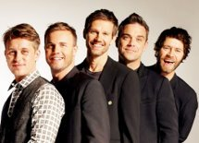
Bournes Green Schools
.
Believe, Grow, Succeed
Autumn 2 2024 Artist of the Half Term – Take That
Take That are an English pop group formed in Manchester in 1990. The group currently consists of Gary Barlow, Howard Donald and Mark Owen. The original line-up also featured Jason Orange and Robbie Williams. Barlow acts as the group's lead singer and primary songwriter, with Owen and Williams initially providing backing vocals and Donald and Orange serving primarily as dancers.
The group have had 28 top 40 singles and 17 top 5 singles in the United Kingdom, 12 of which have reached number one, as well as having eight number one albums. Internationally, the band have had 56 number one singles and 39 number one albums. They have received eight Brit Awards including for Best British Group and Best British Live Act.
In 2012, the band were announced by Forbes as the fifth highest-earning music stars in the world. In the same year, the Official Charts Company revealed the biggest-selling singles artists in British music chart history with Take That currently placed at 15th overall, making them the most successful boy band in UK chart history with four of their albums listed in the best-selling albums of the millennium.
Take That have produced world tours, sold millions of albums worldwide and raised
millions of pounds for a number of charities. These include Breast Cancer Care,
Children in Need, Comic Relief, Help for Heroes and The Princes Trust.

Slide 2
Bournes Green Schools
.
Believe, Grow, Succeed
Welcome!
(Executive) Headteacher - Mr Denchfield
Deputy Headteachers - Mrs Goy and Mr Kent

Slide 3
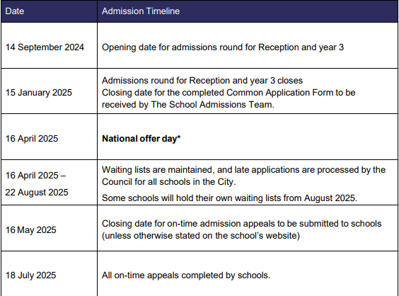
Bournes Green Schools
.
Believe, Grow, Succeed
Southend Primary School Admissions 2025

Slide 4
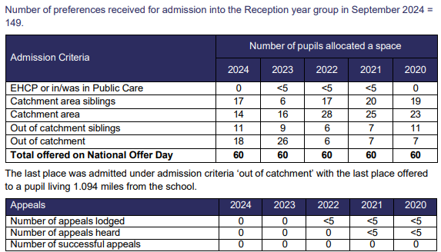
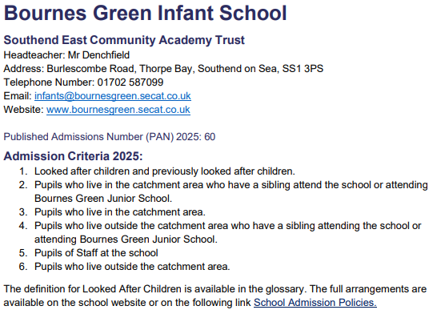
Bournes Green Schools
.
Believe, Grow, Succeed
Bournes Green Infant School Admissions 2025

Slide 5
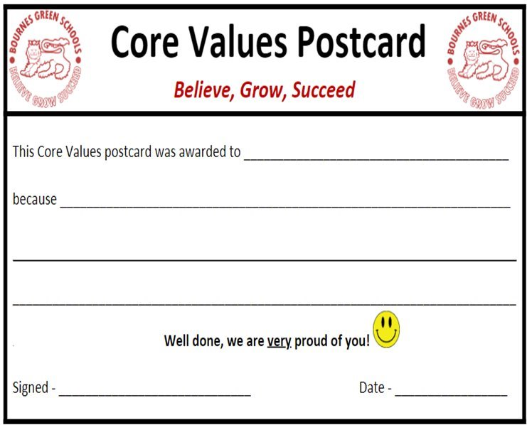
Bournes Green Schools
Believe, Grow, Succeed
Our Core Values
Believe - We believe in ourselves and each other in all that we do, even when faced with challenges.
Grow - We grow as individuals and become better people in every way. We take great pride in helping others grow. ​
Succeed - We always try our best. We celebrate our own and other’s successes, inside and outside of school. We are proud of every achievement. ​

Slide 6
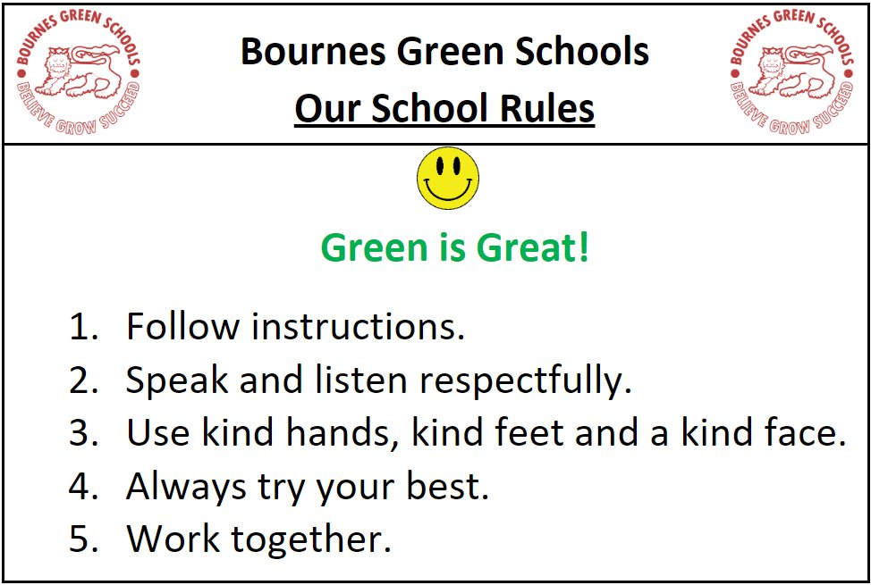

B O U R N E S G R E E N S C H O O L S
.
Believe, Grow, Succeed
Bournes Green Schools
Believe, Grow, Succeed
Our School Rules

Slide 7
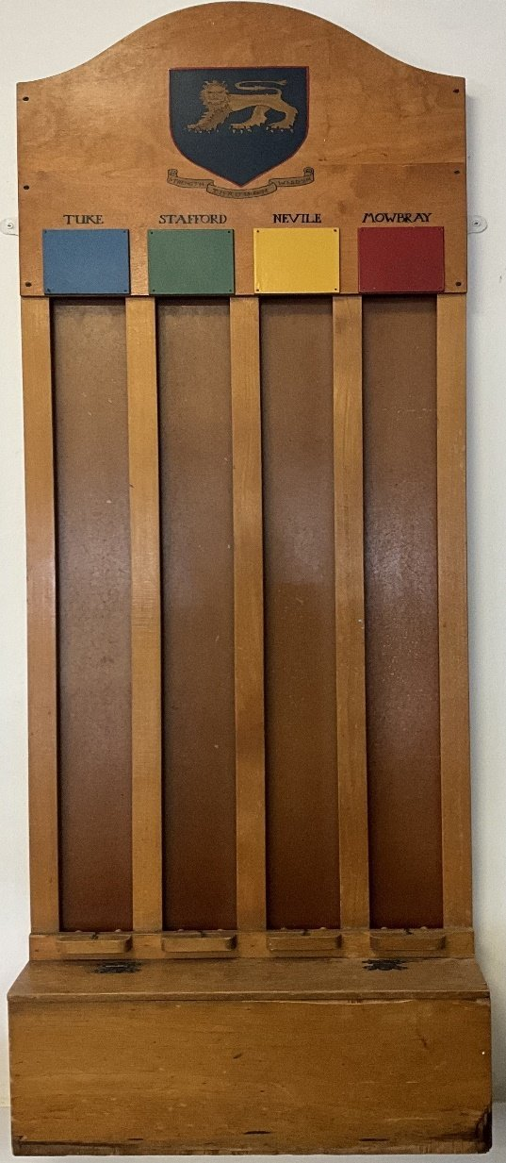
Bournes Green Schools
Believe, Grow, Succeed
Our Houses
Tuke
Stafford
Nevile
Mowbray

Slide 8
Bournes Green Schools
Believe, Grow, Succeed
Our wider offer….
Outdoor Learning Area
Sports pitch
Lots of clubs (including Breakfast/After School Club)
Infant Library
Art gallery
UoBG
Access to a big school field
Special weeks/days (Science Week, Book Week, British Black History Day, Mental Health Week)
Special wider school events (e.g. Harvest, Remembrance, Christmas, Easter Bonnet Parade, Pantomime)
Parents Association events (Colour Run, Christmas Fayre, Summer Fayre, Ice Cream final day treat)
Sports competitions and Sports Day
Educational Visits (e.g. Danbury, Barleylands)

Slide 9
Bournes Green Schools
Believe, Grow, Succeed
Our wider offer….
Artist of the Half Term
Language of the month
Fact of the week
Celebration Assembly
Join assemblies with the Juniors
Learning Mentors (Mrs Baker/Mrs Westlake)
Votes for Schools
Learning Partners
Online Worry Box
School Council (Charity work)
Eco-Council
Pupil Advocates

Slide 10
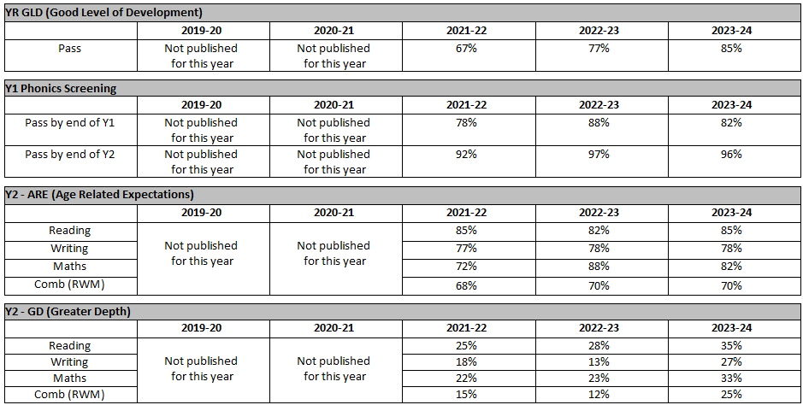
Bournes Green Schools
Believe, Grow, Succeed
Infant Outcomes

Slide 11
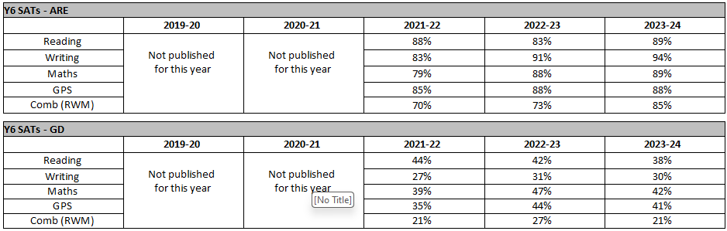
Bournes Green Schools
Believe, Grow, Succeed
Junior Outcomes

Slide 12
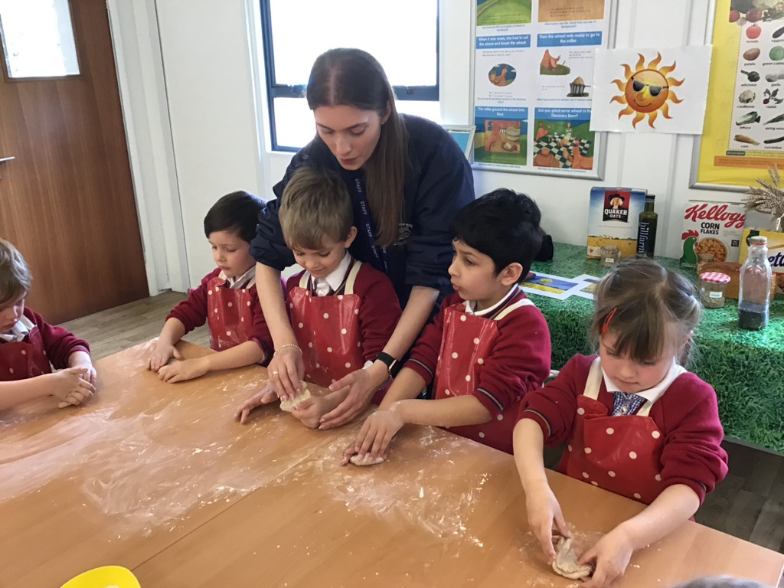
Bournes Green Schools
Believe, Grow, Succeed
EYFS Curriculum
Our curriculum focuses highly on the development of vocabulary and the child as a whole person.
It is important to us that your child is seen as a unique individual who is resilient, capable, confident and self-assured.
Independence is encouraged alongside building positive relationships with both children and staff.
We adapt and plan our curriculum to meet the needs of the children.

Slide 13
Bournes Green Schools
Believe, Grow, Succeed
Curriculum Areas
Personal, social and emotional development (building relationships, self-regulation and managing self)
Communication and language (listening, attention and understanding and speaking)
Physical development (gross motor skills and fine motor skills)
Literacy (comprehension, word reading and writing)
Mathematics (number and numerical patterns)
Understanding the world (people, culture and communities, the natural world and past and present)
Expressive arts and design (creating with materials and being imaginative and expressive)

Slide 14

Bournes Green Schools
Believe, Grow, Succeed
Phonics
We follow a government validated systematic synthetic phonics programme called ‘Little Wandle Letters and Sounds revised’
Phonics is an integral part of children's learning. It is the foundation for their reading and writing and is taught daily throughout the year.
We offer workshops to support parents through our phonics work.

Slide 15
Bournes Green Schools
Believe, Grow, Succeed
Lunch
All children in the Infants are eligible for a free school dinner should you wish.
School Dinners are ordered via through MCAS app.
If your child would rather a packed lunch, please pack enough food that they will eat. Please ensure you clearly label the lunchbox with your child’s name.
Please provide your child with a named water bottle.
We are an allergy aware school.
Please do not send any nut products into school via lunchboxes or donated items.

Slide 16
Bournes Green Schools
Believe, Grow, Succeed
Inclusion Team
Mrs Goy (Inclusion Lead)
Mrs Baker (Learning Mentor)
Mrs Groves (SENCO)
Please do get in touch if you need any support or advice. We want to help!

Slide 17
Bournes Green Schools
Believe, Grow, Succeed
Attendance & Punctuality
Holidays during term time are not authorised and you will likely incur a fine. We do not provide homework to take on holiday.
If you are struggling to get your child into school for any reason, please speak to us and we will do our best to support you.
Infant School times
8-35am - Soft start (children may come into school from this time)
8-40am - Official start to the School Day
3-10pm - End of the School Day

Slide 18
Bournes Green Schools
Believe, Grow, Succeed
Communication
Class emails (e.g. RN@bournesgreen.secat.co.uk, 2B@bournesgreen.secat.co.uk )
School Office
Gate Duty
Parents Evenings
Book Looks in the Autumn and Spring Term
Open Evening in the Summer Term
Weekly Newsletter
Website
Social Media (X/Instagram)
Workshops/Stay and Play
Parent Partnership
My Child at School App (MCAS)
Tapestry

Slide 19

Bournes Green Schools
Believe, Grow, Succeed
Questions?
Thank you for coming, and good luck with your application!

Slide 20
Bournes Green Schools
.
Believe, Grow, Succeed
Autumn 2 2024 Artist of the Half Term – Take That
Take That are an English pop group formed in Manchester in 1990. The group currently consists of Gary Barlow, Howard Donald and Mark Owen. The original line-up also featured Jason Orange and Robbie Williams. Barlow acts as the group's lead singer and primary songwriter, with Owen and Williams initially providing backing vocals and Donald and Orange serving primarily as dancers.
The group have had 28 top 40 singles and 17 top 5 singles in the United Kingdom, 12 of which have reached number one, as well as having eight number one albums. Internationally, the band have had 56 number one singles and 39 number one albums. They have received eight Brit Awards including for Best British Group and Best British Live Act.
In 2012, the band were announced by Forbes as the fifth highest-earning music stars in the world. In the same year, the Official Charts Company revealed the biggest-selling singles artists in British music chart history with Take That currently placed at 15th overall, making them the most successful boy band in UK chart history with four of their albums listed in the best-selling albums of the millennium.
Take That have produced world tours, sold millions of albums worldwide and raised
millions of pounds for a number of charities. These include Breast Cancer Care,
Children in Need, Comic Relief, Help for Heroes and The Princes Trust.

