Slide 1
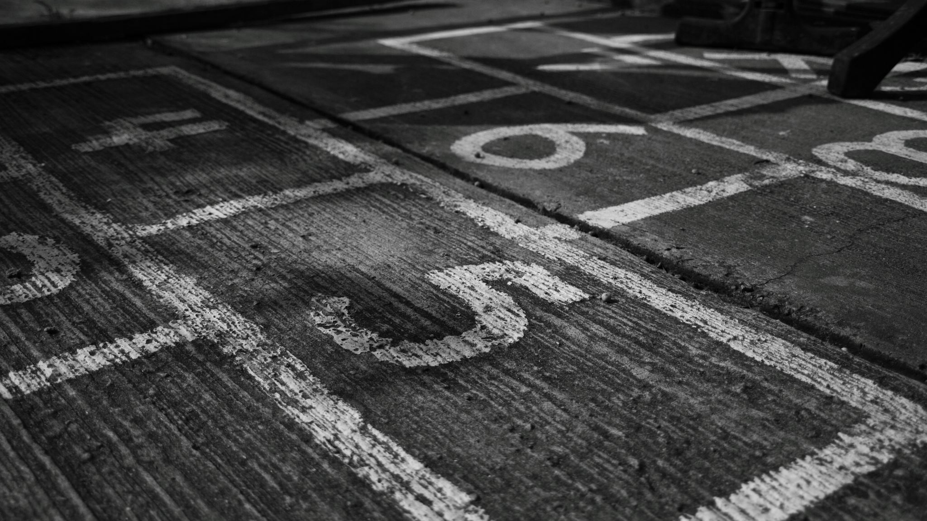
Mastery in Number

Slide 2
Point of the program
Why have we chosen this program?
These lessons are 10-15 minutes and are taught every day from Reception to Year 6. This is in addition to a regular maths lesson.
It works to secure firm foundations in the development of good number sense for all children. The aim over time is that children will develop fluency in arithmetic and a confidence and flexibility with number. It develops a deep understanding of number and its relationships within other areas such as problem solving; a key element of our daily maths teaching.

Slide 3
The Core Principles of Mastery
Deep Understanding: Mastery isn’t just about knowing the answer; it’s about understanding the 'why' behind the process.
Fluency: Ensuring that children can recall and apply mathematical facts quickly and accurately. They are also making connections between the mathematics.
Problem Solving: Developing the ability to apply number skills in different contexts.
Reasoning: Encouraging children to explain and justify their thinking.

Slide 4
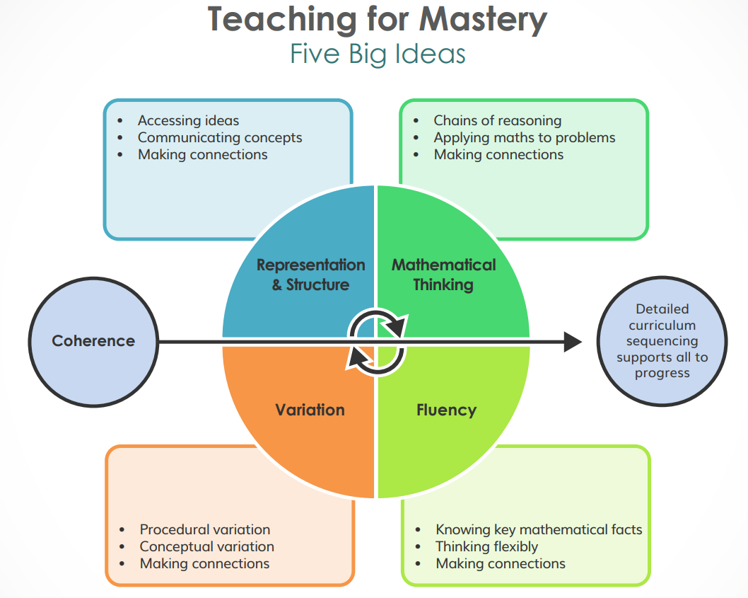

Slide 5
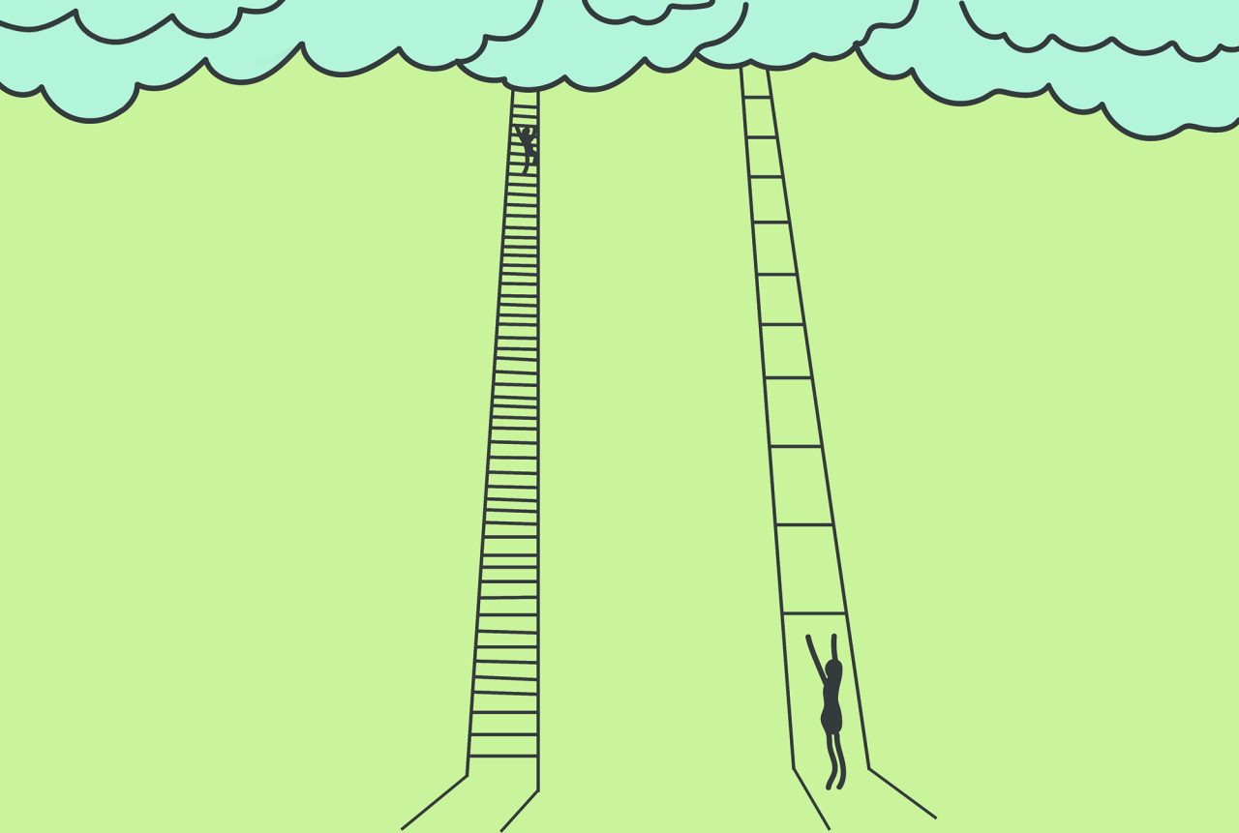
Key Features of the Programme
Concrete-Pictorial-Abstract Approach:
  Concrete: Using physical objects or manipulatives to represent mathematical concepts. This could include rekenreks, cubes or counters.
  Pictorial: showing the maths structures. This could include ten frames, dice patterns or pictures of groups)
  Abstract: Working with numbers and symbols to perform calculations and solve problems.
Small Steps Progression: Teaching concepts in manageable steps ensures that children build on what they know, gradually progressing to more complex ideas.
Inclusive for All Learners: Every child has access to the same high-quality, challenging content, with appropriate support to meet individual needs.
Let's will explore some of the above in more detail.

Slide 6
Different structures
Rekenrek
Ten frames – and 9 frames, 8 frames, 7 frames, 6 frames, 5 frames etc
Hungarian dice patterns
Part whole models
Number lines
STEM Sentences
Subitising
Number Blocks
Picture Representations
Dienes
100 Squares
Bar Models

Slide 7
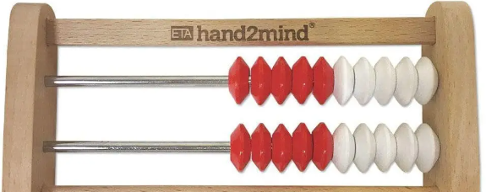
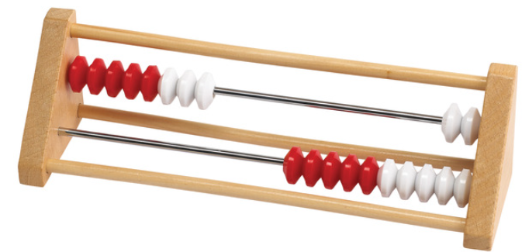
Rekenrek
What is a rekenrek and how do we use it?
'White to the right'
'Reds ready'
'In play'
'Top row, bottom row, both rows'

Slide 8
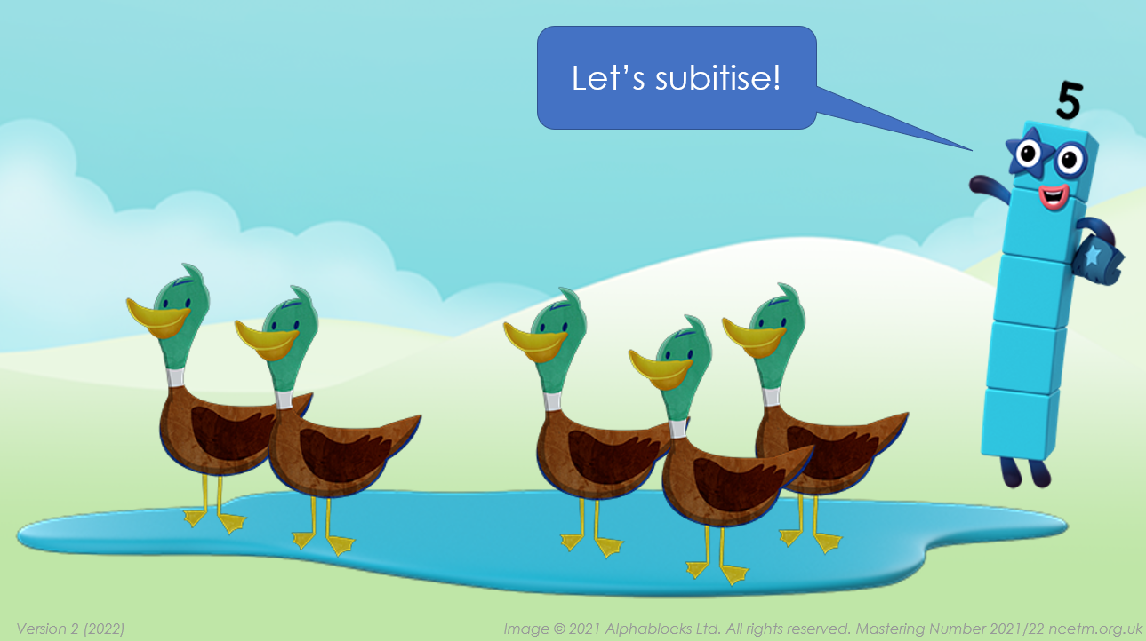

Slide 9

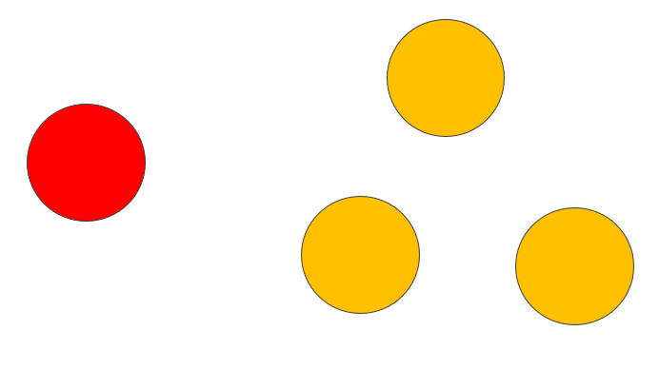
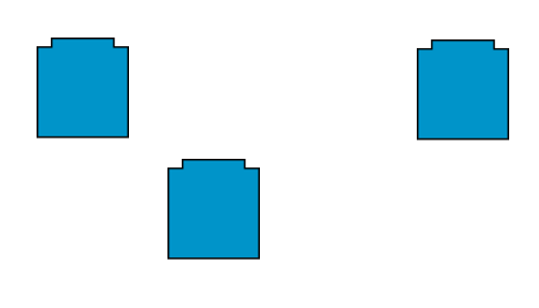
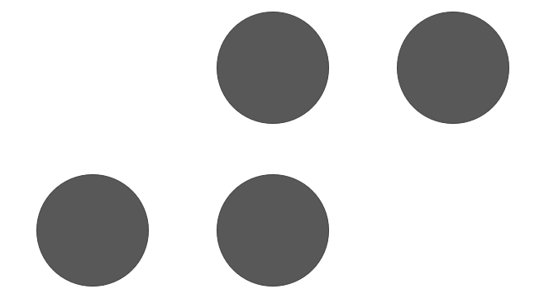
Subitising

Slide 10
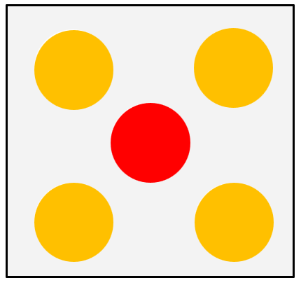
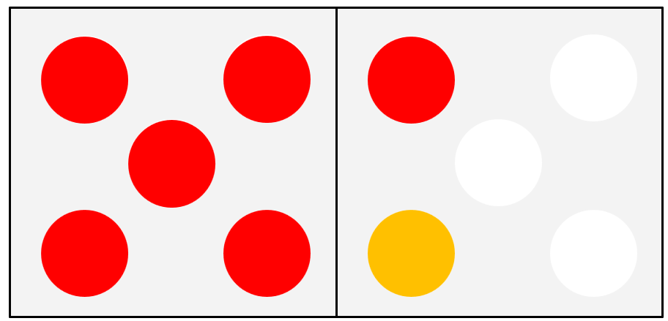
Hungarian Dice Patterns

Slide 11
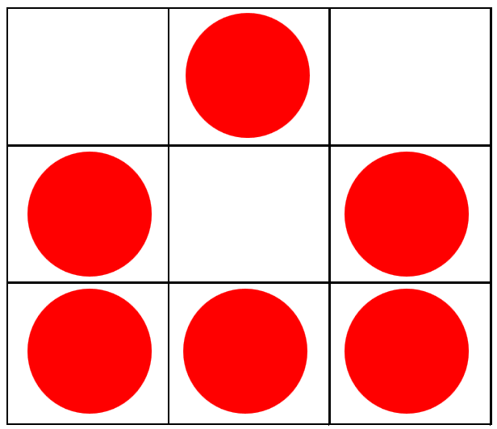
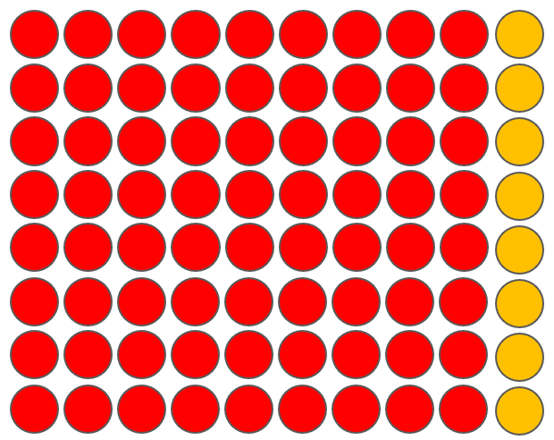
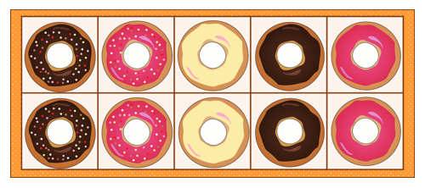
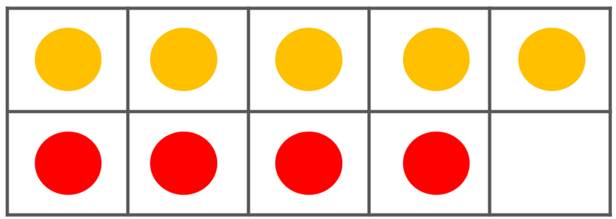
Frames

Slide 12
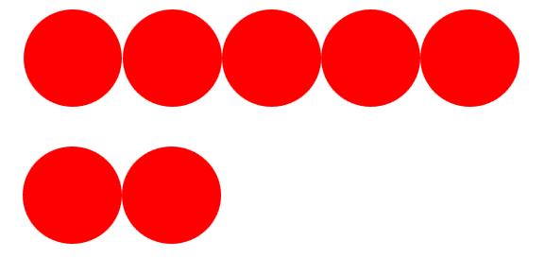
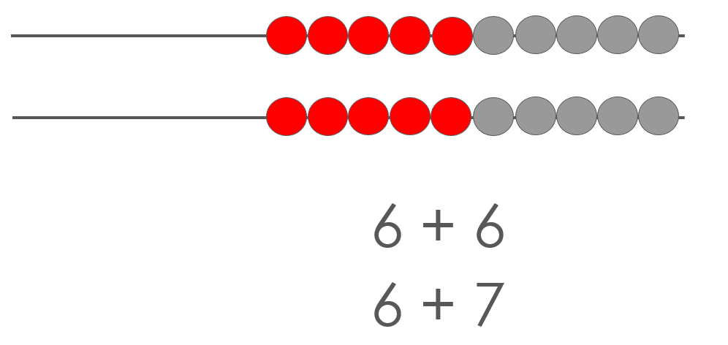
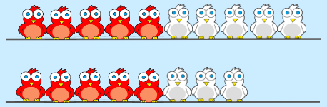
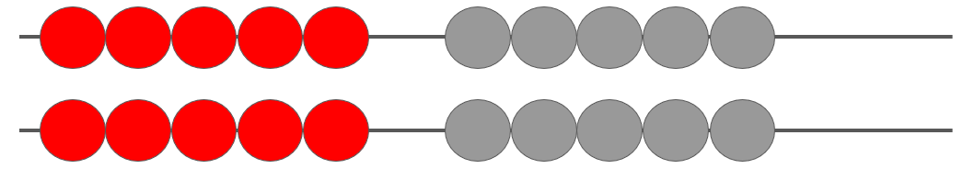
Rekenrek patterns

Slide 13
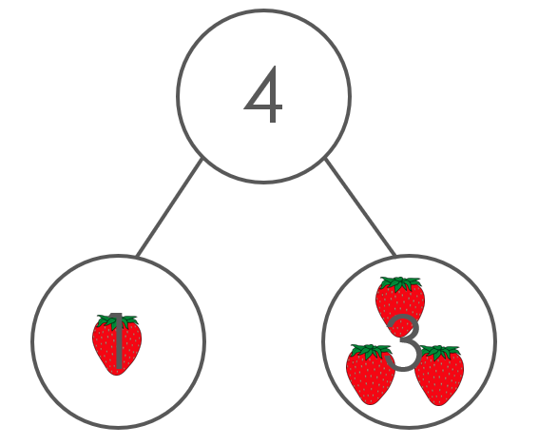
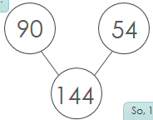
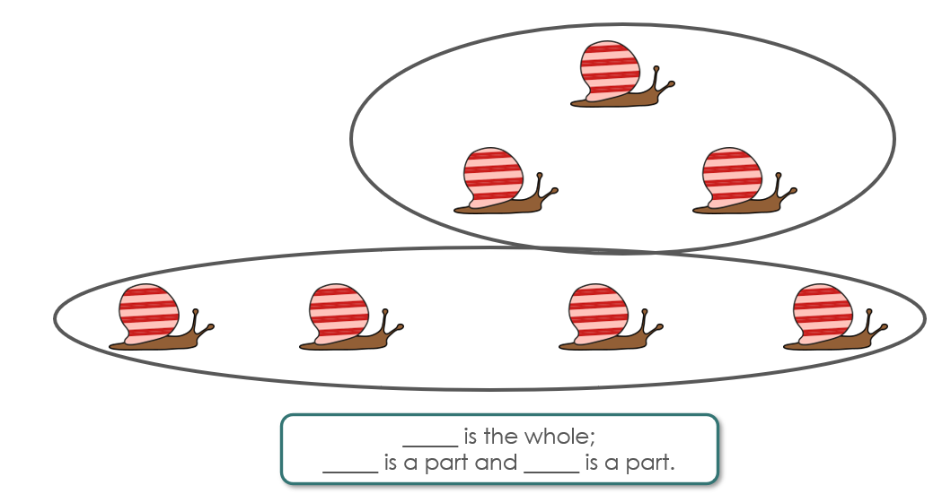
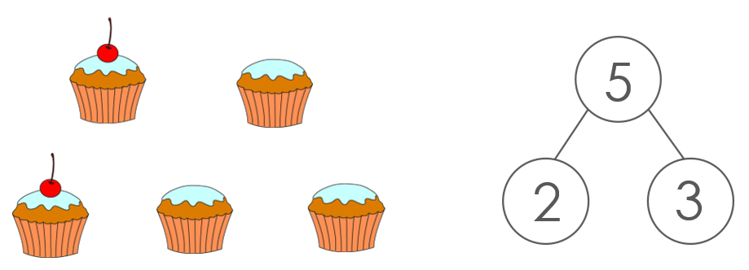
Parts and Whole

Slide 14

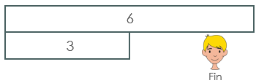
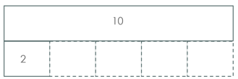
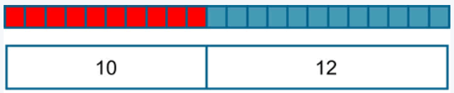
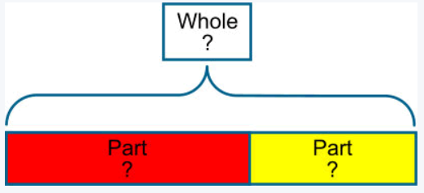
Bar Models

Slide 15
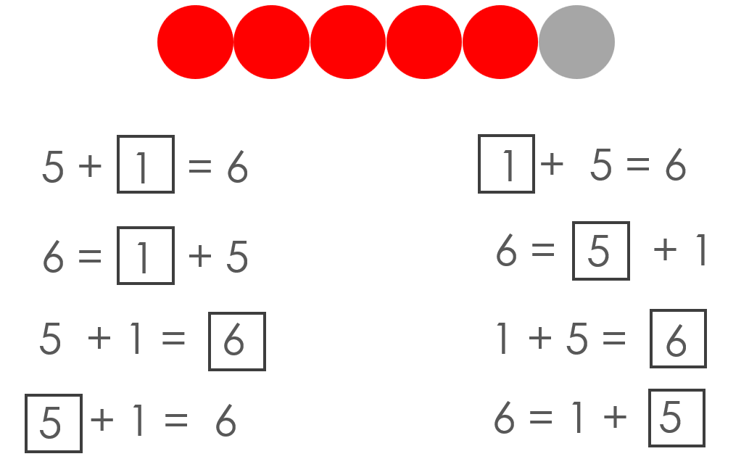
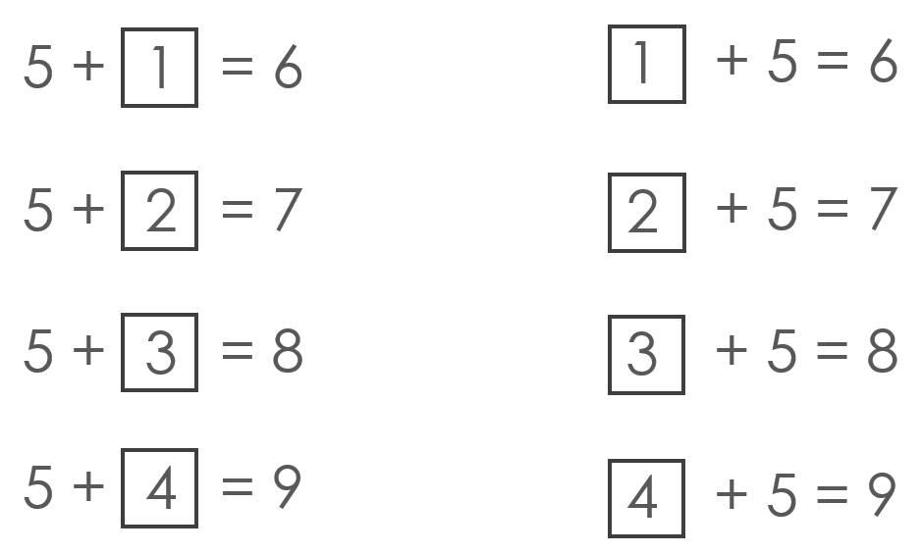
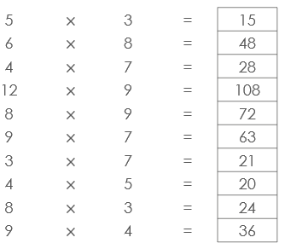
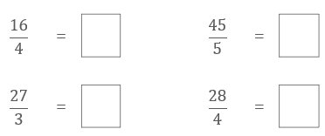
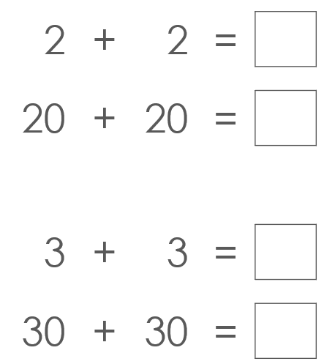
Equations and Expressions

Slide 16
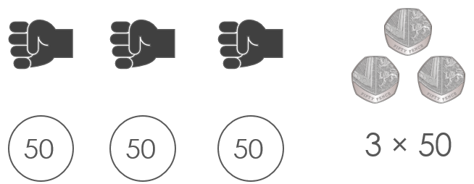
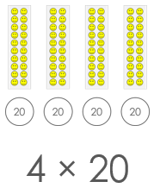
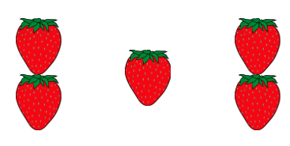

Picture Representations

Slide 17
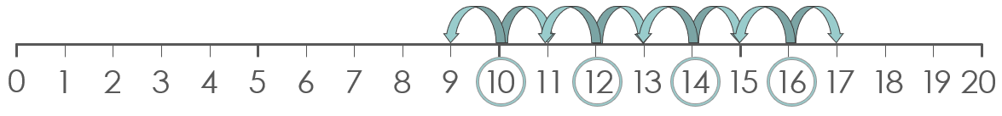
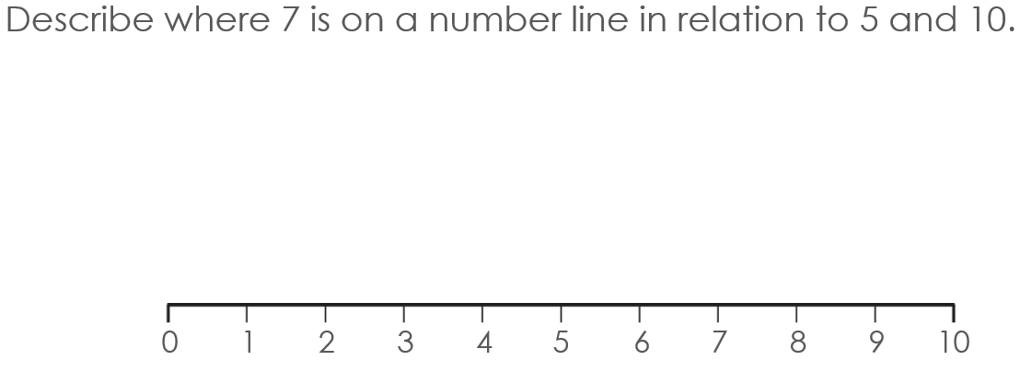
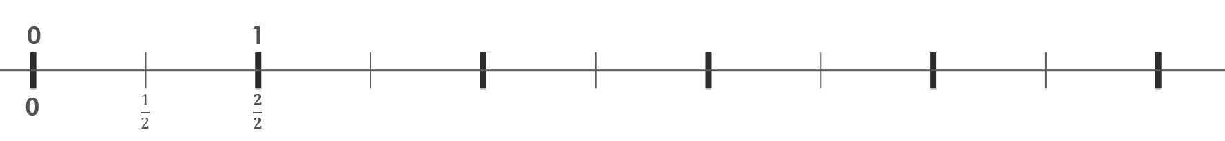
Number lines

Slide 18
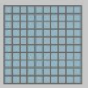
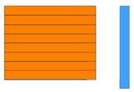
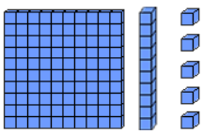
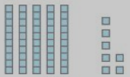
Dienes

Slide 19
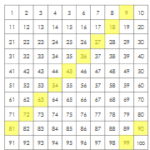
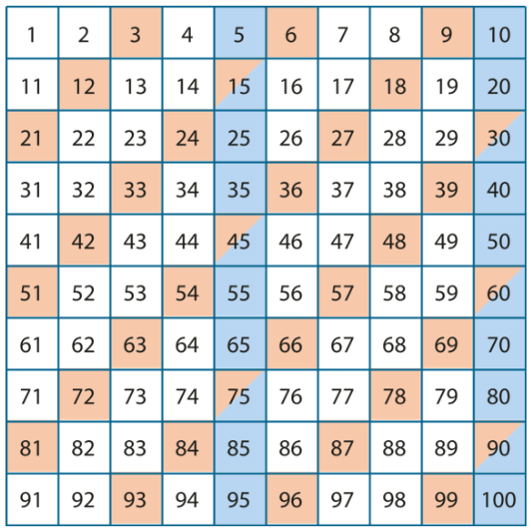
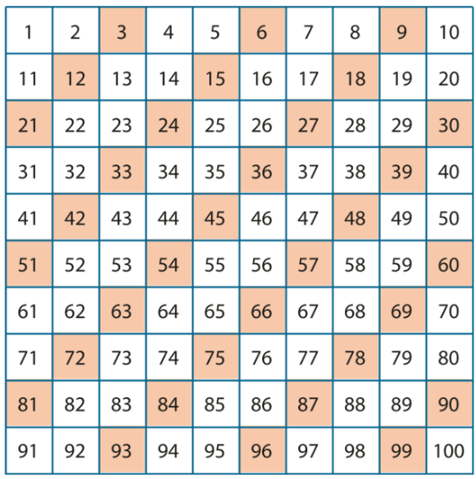
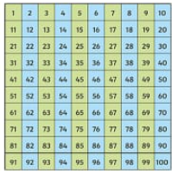
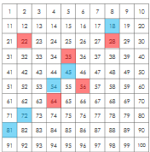
100 Squares

Slide 20
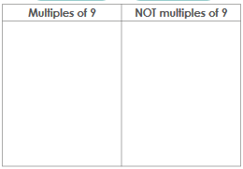
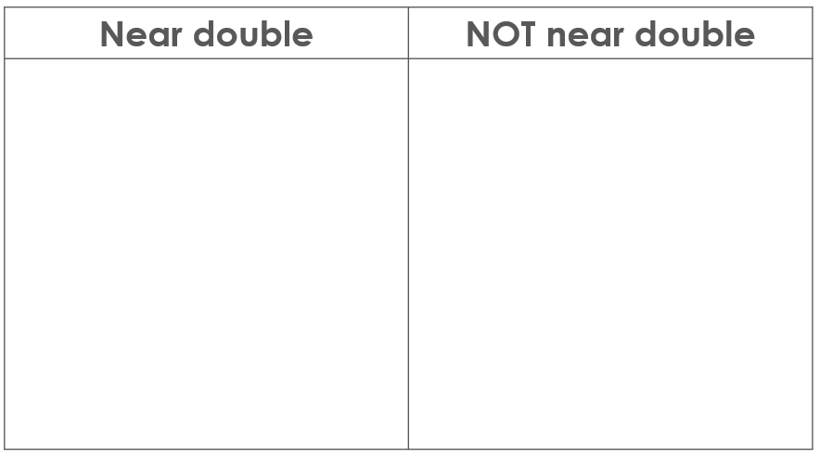
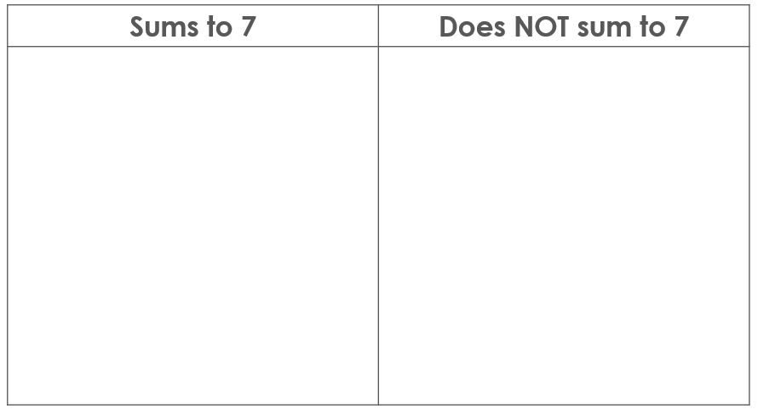

True/False

Slide 21



STEM Sentences

Slide 22
Support
If you would like to find out more, you can visit the websites below;
Numberblocks is a frequently used element of the program and a great program to watch at home. Numberblocks - BBC iPlayer
You can also find the NCETM YouTube channel that provides many videos of teaching and tips for parents at home here: NCETM - YouTube
You can find more information about what mastery is here: The Essence of Mathematics Teaching for Mastery | NCETM
You can find more information about the 5 Big Ideas here: Five Big Ideas in Teaching for Mastery | NCETM
You can find supporting research for the mastery teaching approach here: Supporting Research, Evidence and Argument | NCETM
You can find an article about improving your child's confidence in maths here: Improving children’s confidence in maths starts with parents | NCETM

