Slide 1


B O U R N E S G R E E N S C H O O L S
.
Believe, Grow, Succeed
Parent Partnership Meeting – Thursday 26th June
Building works update
Nursery update
Questions

Slide 2
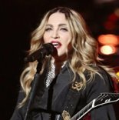
B O U R N E S G R E E N S C H O O L S
.
Believe, Grow, Succeed
Summer 2 2025 Artist of the Half Term – Madonna
Madonna Louise Ciccone was born on 16th August 1958 and is an American singer, songwriter, actress, and businesswoman. Madonna is known for pushing the boundaries of lyrical content in mainstream popular music, as well as visual imagery in music videos and on stage. She has frequently reinvented both her music and image while maintaining autonomy within the recording industry.
At 20, Madonna moved to New York to pursue a career in modern dance. After performing as a drummer, guitarist and vocalist in the music groups Breakfast Club and Emmy, Madonna signed with Sire Records in 1982 and released her debut album the next year. She followed it with a series of successful albums which became global bestsellers and Grammy Award winners. Throughout her career, Madonna has written and produced most of her songs, with many of them reaching number one on the record charts, including “Papa Don’t Preach, “Like a Prayer and “Vogue”.
Madonna's popularity was further enhanced by her roles in films such as Desperately Seeking Susan, Dick Tracey, A league of Their Own and Evita. As a businesswoman, Madonna founded her own entertainment company Maverick, including the label Maverick Records, in 1992. Her other ventures include fashion design, writing children's books, opening of health clubs, and filmmaking. She also contributed in various charities and founded the Raising Malawi organization in 2006.
Having sold more than 300 million records worldwide, Madonna is recognized as the best-selling female recording
artist of all time by The Guinness World Records. She is also the highest-grossing solo touring artist of all time,
earning £1,000,000,000 from her concert tickets!

Slide 3
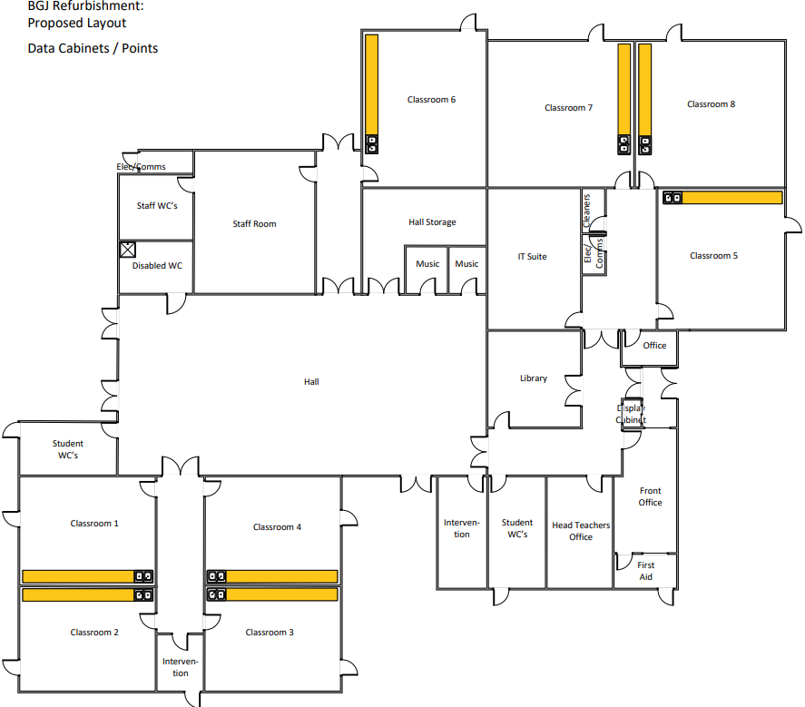
B O U R N E S G R E E N S C H O O L S
.
Believe, Grow, Succeed
Building Works Update

Slide 4
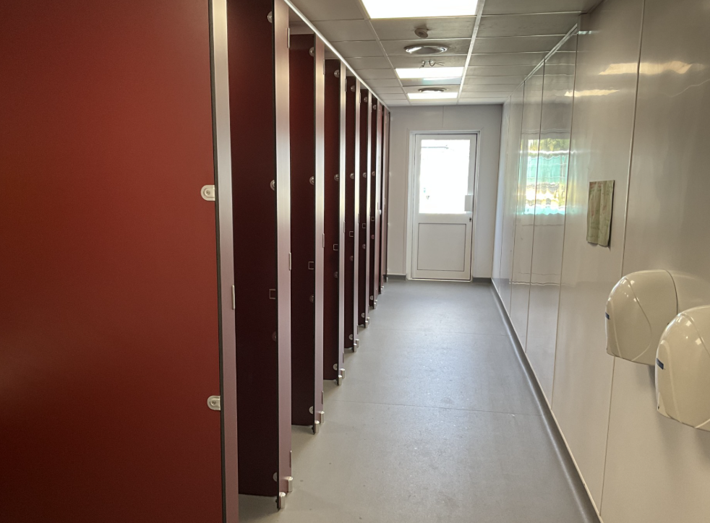
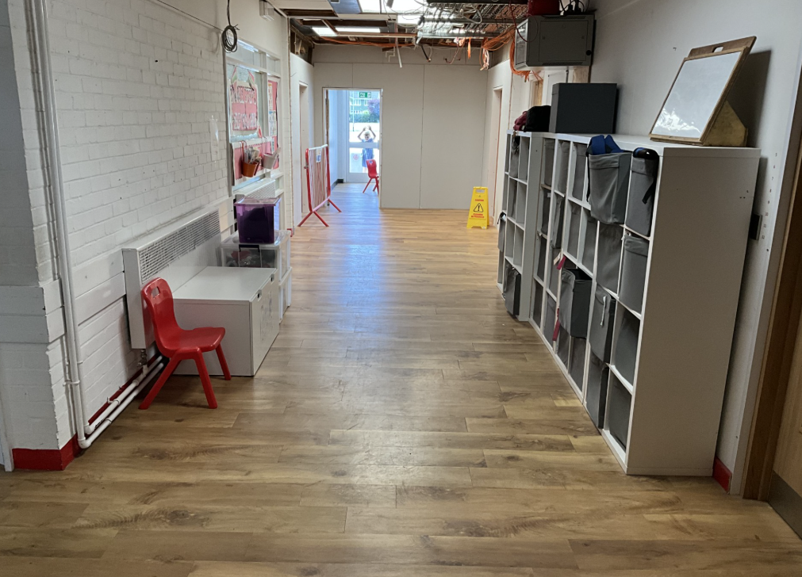
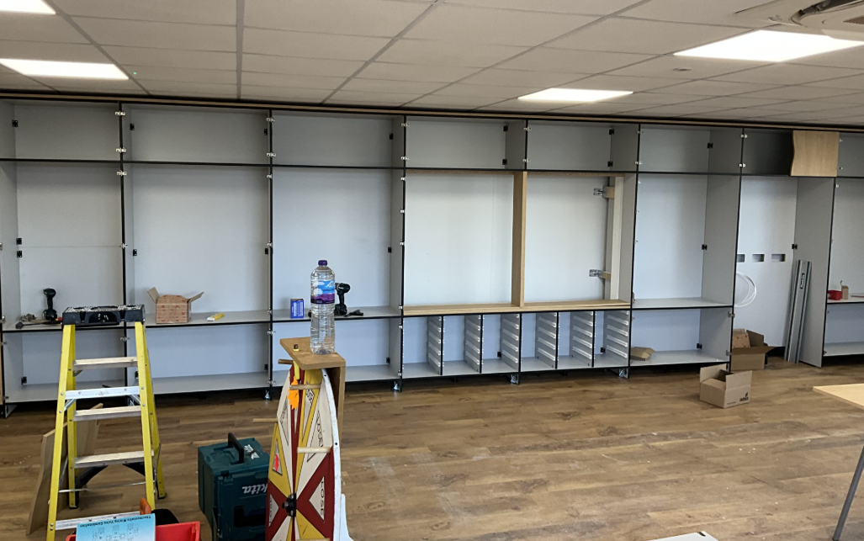
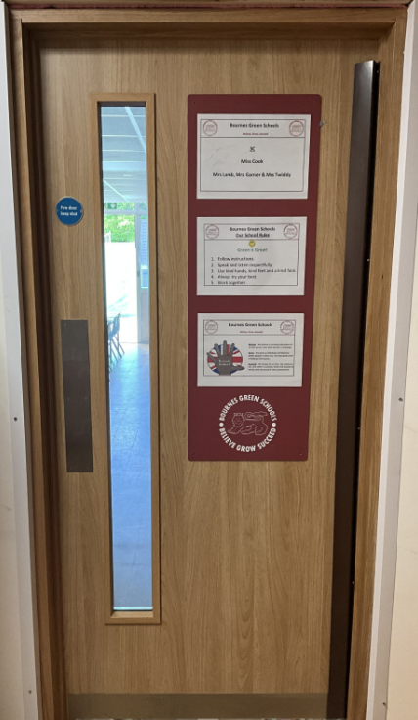
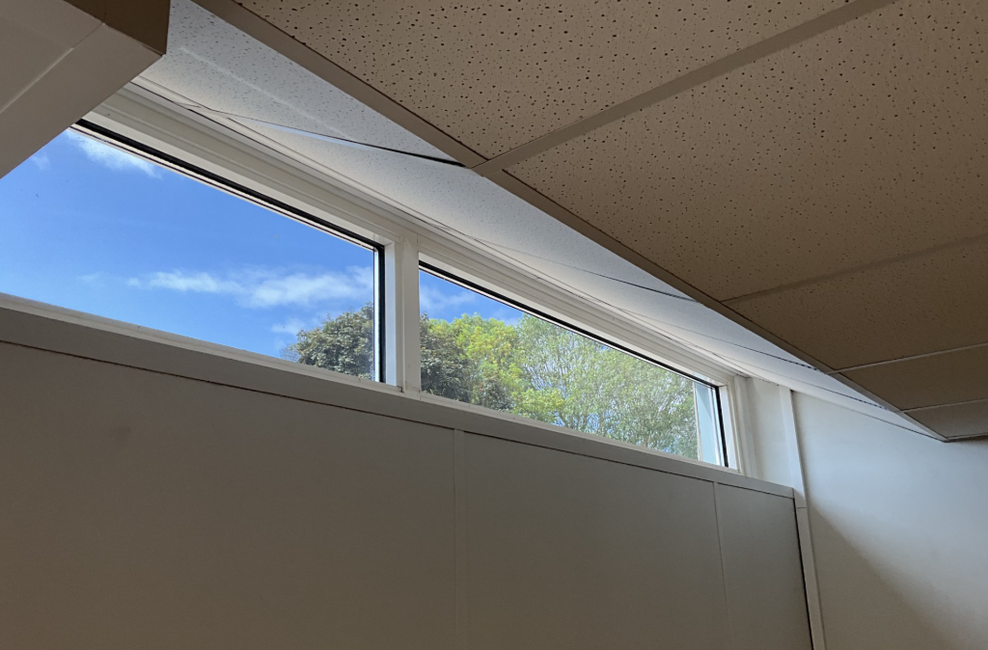
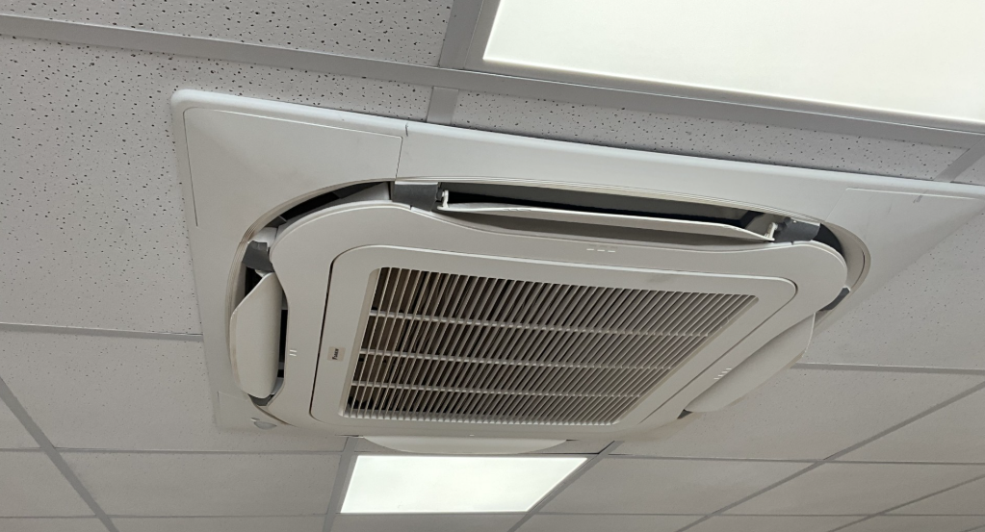
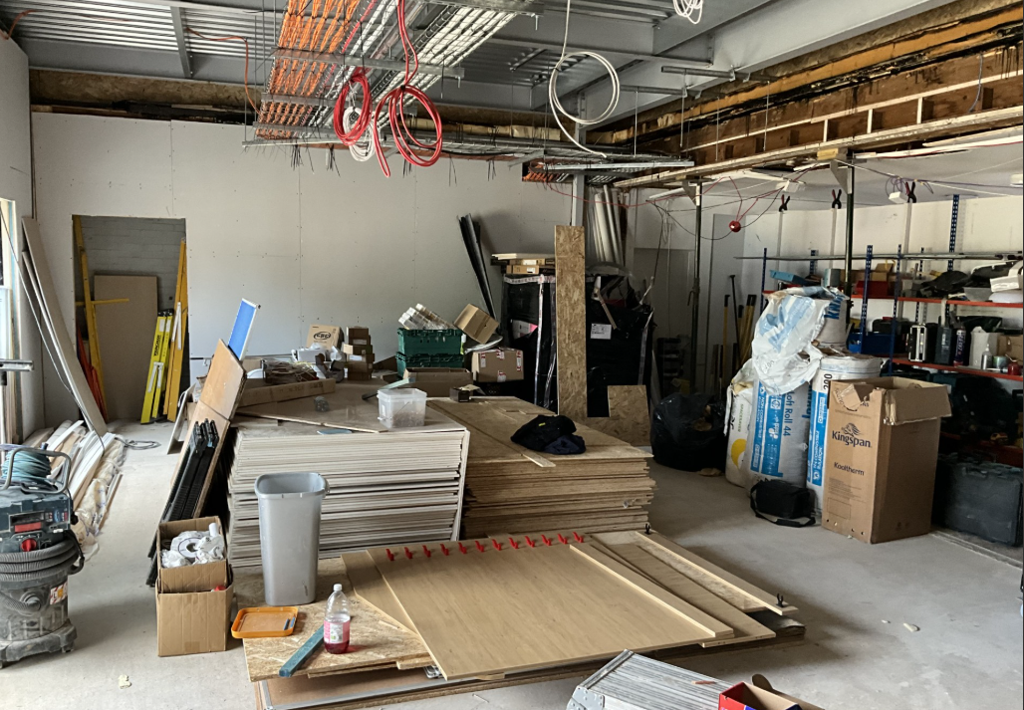
B O U R N E S G R E E N S C H O O L S
.
Believe, Grow, Succeed
Building Works Update

Slide 5
B O U R N E S G R E E N S C H O O L S
.
Believe, Grow, Succeed
Nursery Update
DfE agree to a delay in our Nursery opening.
Trust currently in discussions with an external contractor to undertake the works
Expression of Interest Form for nursery places is now open.
The official application process will begin in September 2025. Families who have submitted an Expression of Interest will be contacted at that time with full details of the admissions process.
Planned nursery provision start dates:
3–4 Year Old Room: Opening in January 2026
2 Year Old Room: Opening after the Easter Break in 2026

Slide 6
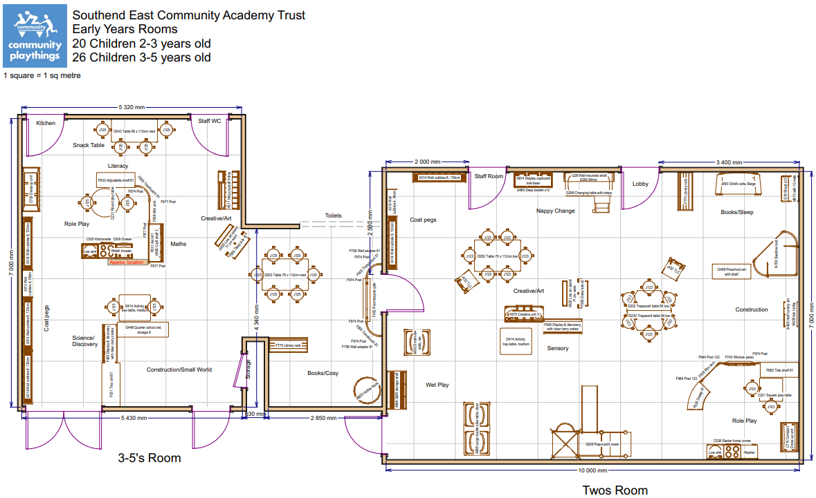
B O U R N E S G R E E N S C H O O L S
.
Believe, Grow, Succeed
Nursery Update
Initial draft design. This is currently being revised (e.g. it does not include the conservatory)
Current bungalow

Slide 7
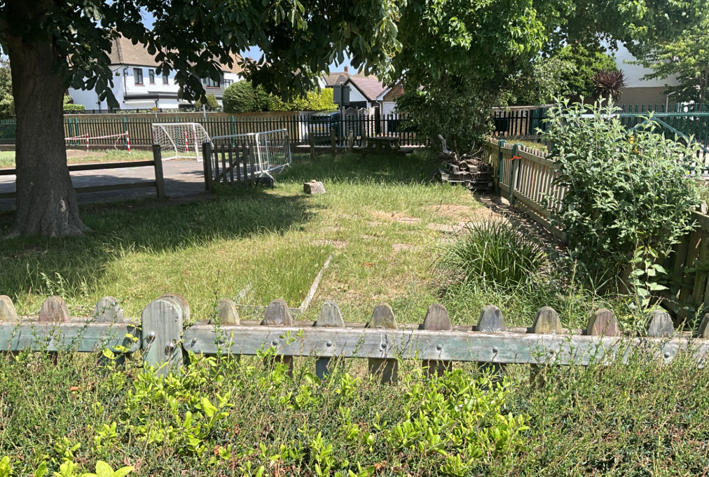
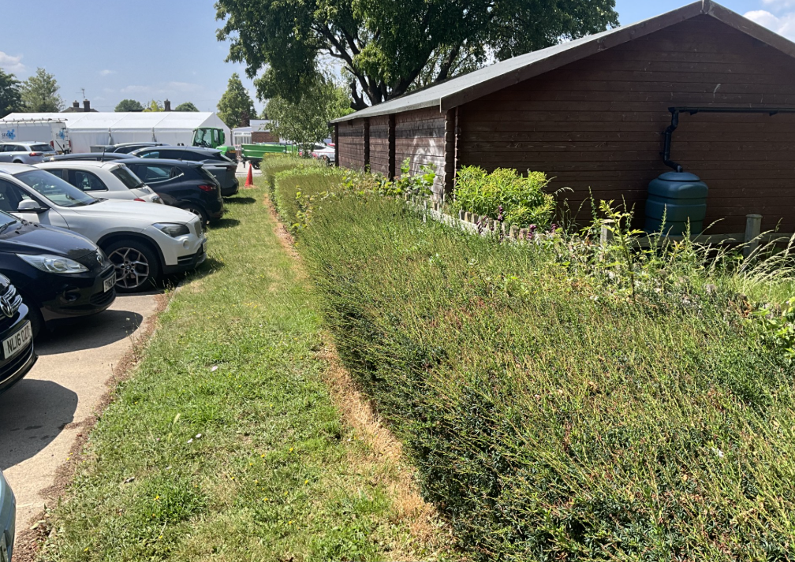
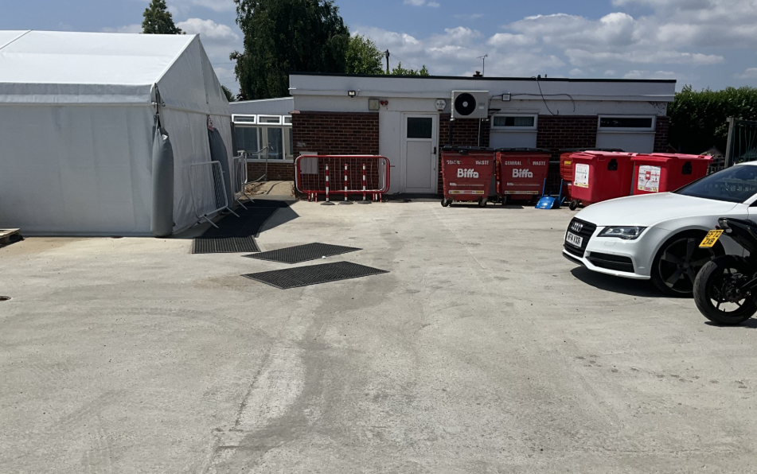
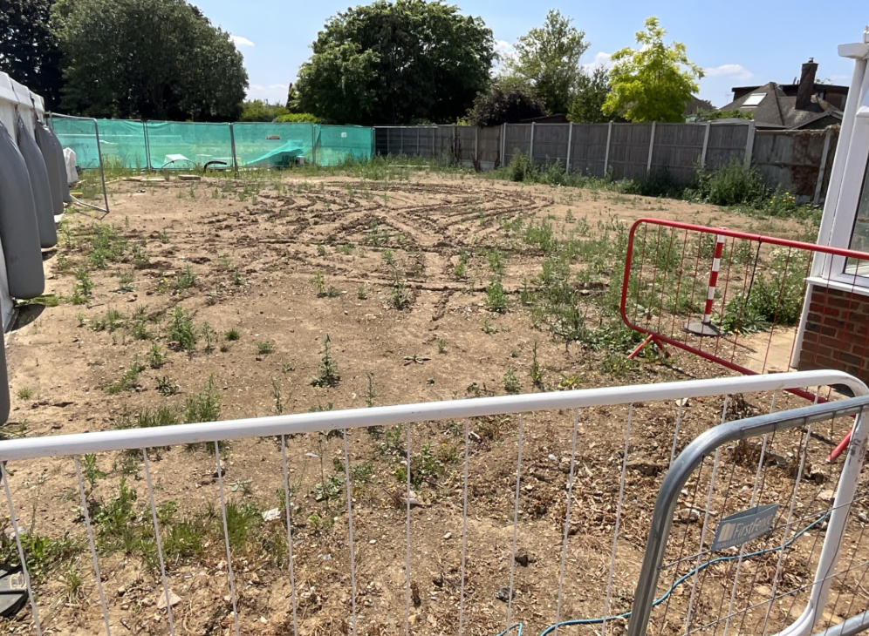
B O U R N E S G R E E N S C H O O L S
.
Believe, Grow, Succeed
Nursery Update

Slide 8
B O U R N E S G R E E N S C H O O L S
.
Believe, Grow, Succeed
Summer 2 2025 Artist of the Half Term – Madonna
Madonna Louise Ciccone was born on 16th August 1958 and is an American singer, songwriter, actress, and businesswoman. Madonna is known for pushing the boundaries of lyrical content in mainstream popular music, as well as visual imagery in music videos and on stage. She has frequently reinvented both her music and image while maintaining autonomy within the recording industry.
At 20, Madonna moved to New York to pursue a career in modern dance. After performing as a drummer, guitarist and vocalist in the music groups Breakfast Club and Emmy, Madonna signed with Sire Records in 1982 and released her debut album the next year. She followed it with a series of successful albums which became global bestsellers and Grammy Award winners. Throughout her career, Madonna has written and produced most of her songs, with many of them reaching number one on the record charts, including “Papa Don’t Preach, “Like a Prayer and “Vogue”.
Madonna's popularity was further enhanced by her roles in films such as Desperately Seeking Susan, Dick Tracey, A league of Their Own and Evita. As a businesswoman, Madonna founded her own entertainment company Maverick, including the label Maverick Records, in 1992. Her other ventures include fashion design, writing children's books, opening of health clubs, and filmmaking. She also contributed in various charities and founded the Raising Malawi organization in 2006.
Having sold more than 300 million records worldwide, Madonna is recognized as the best-selling female recording
artist of all time by The Guinness World Records. She is also the highest-grossing solo touring artist of all time,
earning £1,000,000,000 from her concert tickets!

