Slide 1


Bournes Green Schools
.
Believe, Grow, Succeed
Welcome
Executive Headteacher – Mr Martinson
Deputy Headteachers - Mrs Goy and Mr Kent
​
RN - Mrs Nagla and Mrs Rawlinson​
RG -​ Miss Gardner and Mrs Keith

Slide 2
Bournes Green Schools
Believe, Grow, Succeed
Our Core Values
Believe - We believe in ourselves and each other in all that we do, even when faced with challenges.
Grow - We grow as individuals and become better people in every way. We take great pride in helping others grow. ​
Succeed - We always try our best. We celebrate our own and other’s successes, inside and outside of school. We are proud of every achievement. ​

Slide 3
B O U R N E S G R E E N S C H O O L S
.
Believe, Grow, Succeed
Bournes Green Schools
Believe, Grow, Succeed
Our School Rules
Green is Great!
Follow instructions.
Speak and listen respectfully.
Use kind hands, kind feet and a kind face.
Always try your best.
Work together.

Slide 4
Bournes Green Schools
Believe, Grow, Succeed
Houses
Tuke (Blue)
Stafford (Green)
Mowbray (Red)
Nevile (Yellow)

Slide 5

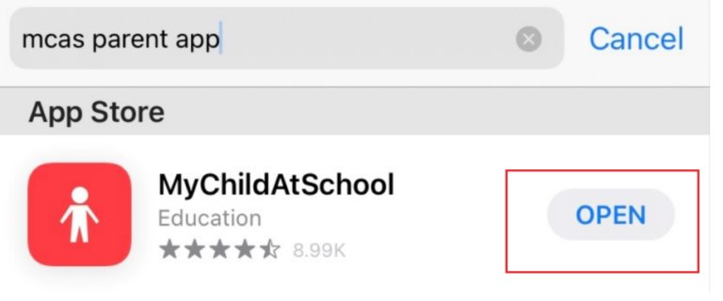
Bournes Green Schools
Believe, Grow, Succeed
Apps
Ensure you are signed up to our Tapestry app to receive observations of your child
throughout the year.
Use the My Child at School (MCAS) app to:
Order lunches
Book parents’ evenings
Booking breakfast and after school club (if you are paying via childcare Vouchers contact the office)
Payments for school trips
Receive school communication (e.g. Weekly newsletter, end of year report)

Slide 6
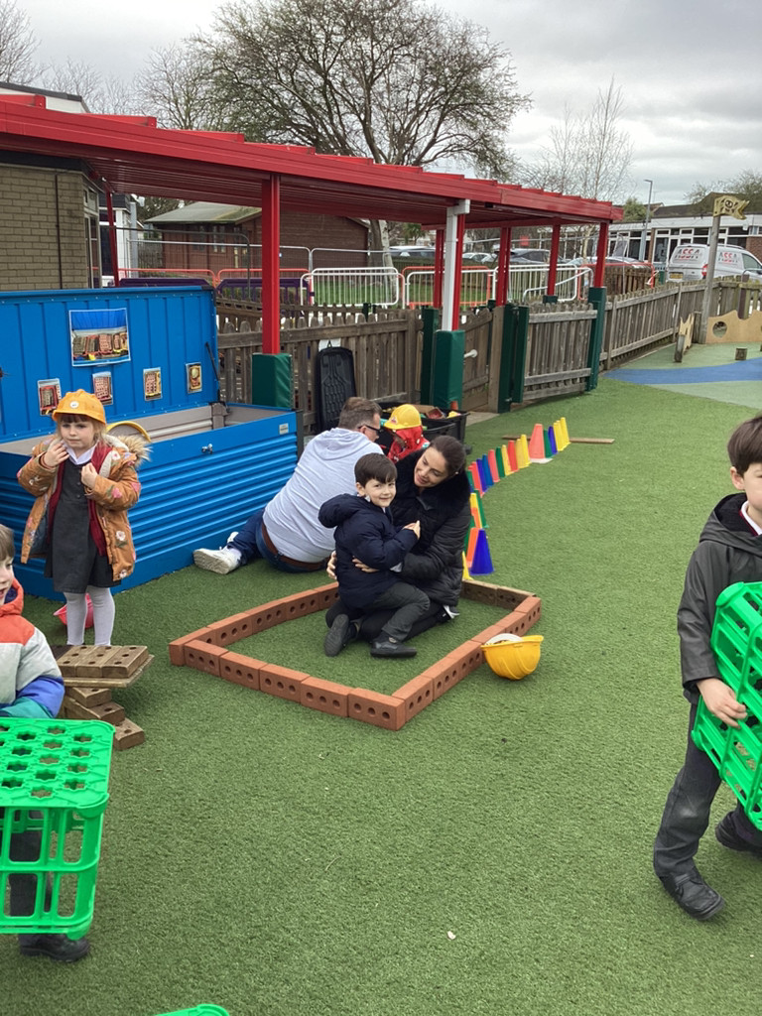
Bournes Green Schools
Believe, Grow, Succeed
The School Day
Mixture of structured and learning through play.
Planned purposeful play in continuous provision.
Children free flow across both classrooms and outdoors as well as focused teacher led activities.
There will be opportunities for parents to experience play and learning with your child and you will be invited to a continuous provision visit.
At lunchtimes, the children will be guided and supported by the adults.
They will join Y1 & Y2 in the playground and will be supported by adults.

Slide 7
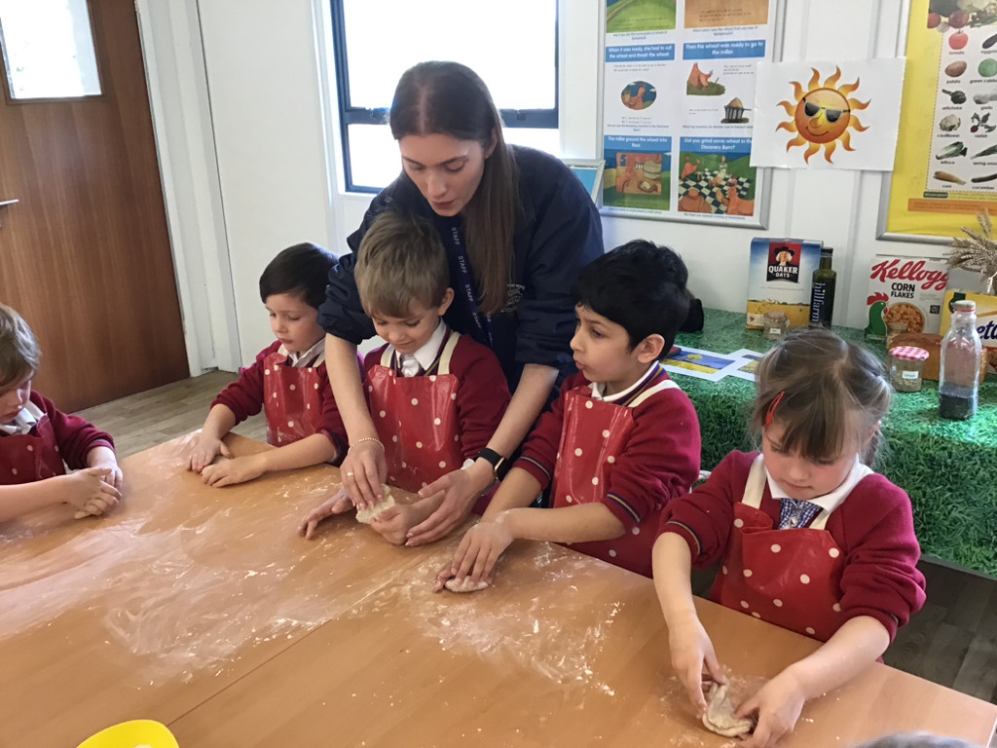
Bournes Green Schools
Believe, Grow, Succeed
Curriculum
Our curriculum focuses highly on the development of vocabulary and the child as a whole person.
It is important to us that your child is seen as a unique individual who is resilient, capable, confident and self-assured.
Independence is encouraged alongside building positive relationships with both children and staff.
We adapt and plan our curriculum to meet the needs of the children.

Slide 8
Bournes Green Schools
Believe, Grow, Succeed
Curriculum Areas
Personal, social and emotional development (building relationships, self-regulation and managing self)
Communication and language (listening, attention and understanding and speaking)
Physical development (gross motor skills and fine motor skills)
Literacy (comprehension, word reading and writing)
Mathematics (number and numerical patterns)
Understanding the world (people, culture and communities, the natural world and past and present)
Expressive arts and design (creating with materials and being imaginative and expressive)

Slide 9
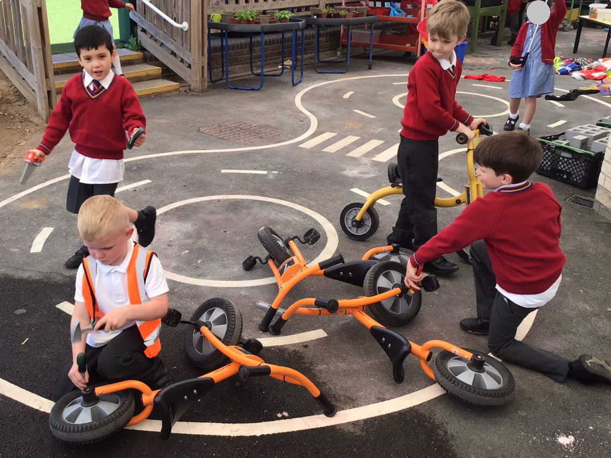
Bournes Green Schools
Believe, Grow, Succeed
Personal, Social and Emotional Development
There is a large emphasis on PSED, especially in the Autumn term when they are settling in. The children are encouraged to:
Share
Take turns
Wait for their turn
Think of others
Learn the rules and boundaries
Listen to instructions
Develop listening and attention skills

Slide 10
Bournes Green Schools
Believe, Grow, Succeed
Phonics
As a school, we follow a government validated systematic synthetic phonics programme called ‘Little Wandle Letters and Sounds revised’
Phonics is an integral part of children's learning. It is the foundation for their reading and writing and is taught daily throughout the year.
Phonics sessions follow a structure that includes:
  Revisit and review: learn a new sound and revisit those previously taught
  Teach and practise: this section will consist of teaching the correct pronunciation, writing the grapheme, blending words, blending and reading words and introducing, learning and revisiting tricky words.
  Practise and apply: this part of the lesson will cover reading phrases and sentences, spelling words and segmenting words.
  Reading: phonics is then followed up by reading decodable books 2 times a week.
  There will be a phonics workshop at the start of the Autumn term
  https://www.Littlewandlelettersandsounds.Org.Uk/resources/for-parents/

Slide 11
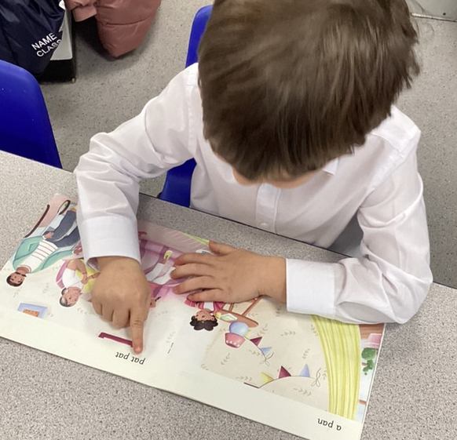
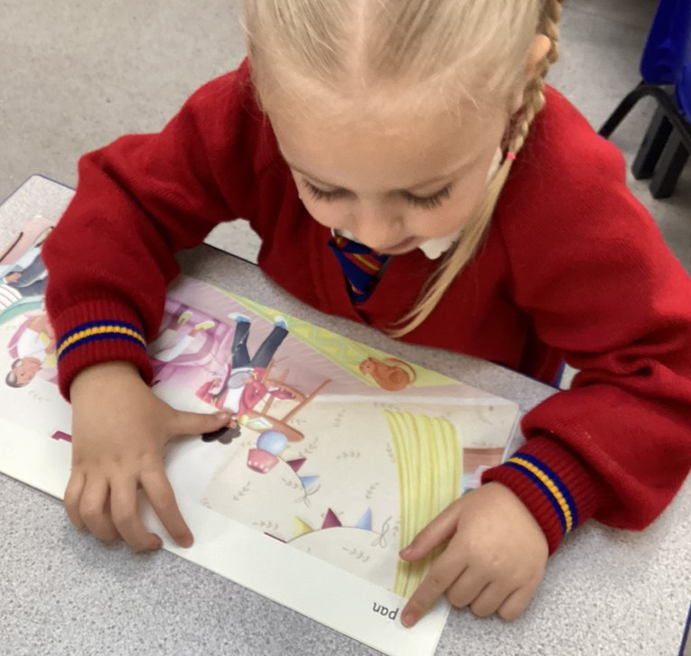
Bournes Green Schools
Believe, Grow, Succeed
Reading
Daily phonics
Every child will have a sound mat and a tricky words list to use at home which will have all the sounds and words we will be learning throughout the year.
A curriculum map will be published on website to inform you of which sounds and words we are learning each week throughout the term
Books are changed weekly. You will receive two phonetically decodable books each week. One that has been read and practised in school plus an additional book to consolidate the skills learnt. We ask that you read both books at home and read at home at least 3 times a week

Slide 12
Bournes Green Schools
Believe, Grow, Succeed
Reading
Reading books are chosen based on your child’s phonetic knowledge, confidence and development. There are multiple factors we consider when placing your child within a book band.
Reading diaries are just for reading comments and is not a communication book. Diaries are monitored to ensure children are reading regularly.
Make time to read to your child as this is just as important.
Please ensure reading books are always kept in their bookbag. (No water bottles in book bags please!)
Library – children will get the opportunity to spend time in the library on a weekly basis. They will be able to choose a book of their choice to take home for the week. Library books are changed once a week. The teacher will let you know which day they will changing library books

Slide 13
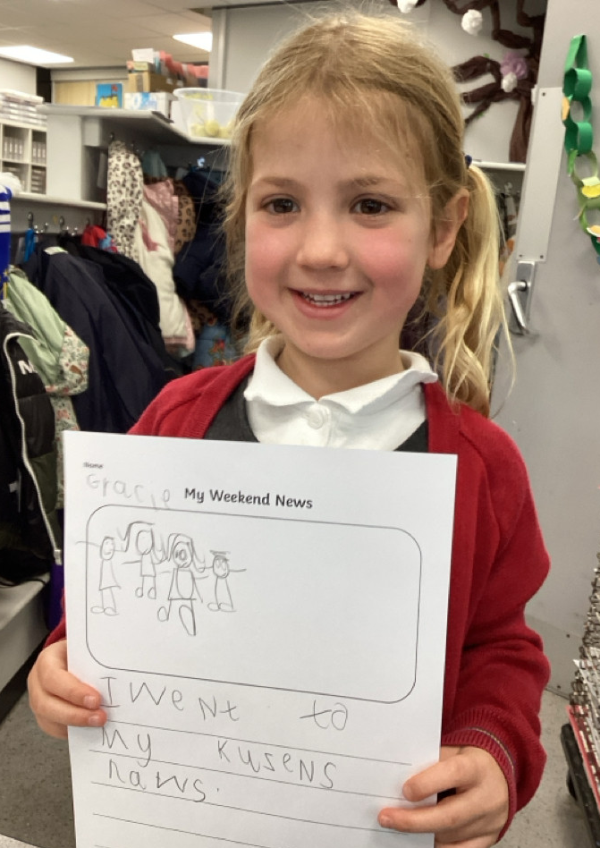
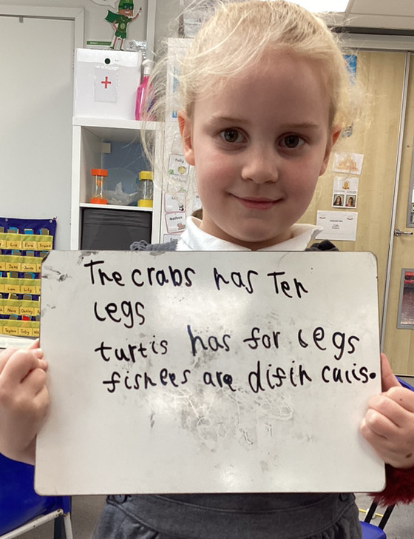
Bournes Green Schools
Believe, Grow, Succeed
Writing
The children are supported throughout the writing process and have opportunities to write independently.
They are encouraged to use the sounds they know to write words.
The children will have regular writing lessons and are expected to write a sentences by the end of the year.
There is a strong focus on development of vocabulary and modelled writing.

Slide 14
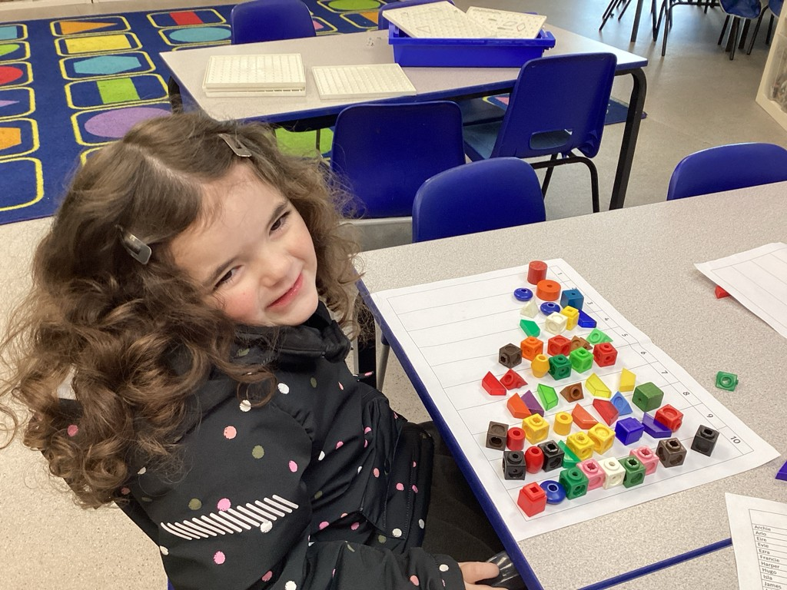
Bournes Green Schools
Believe, Grow, Succeed
Mastery Maths
Maths will follow a weekly structure with daily, short inputs, focusing on developing key skills and maths mastery. This ensures the children have a deep understanding of a concept before moving onto a new concept.
How can you help your child in maths?
Understanding number
One to one correspondence
Match quantities
More and less
Practical activities
Compare quantities, amounts, lengths, heights
Play maths games

Slide 15
Bournes Green Schools
Believe, Grow, Succeed
Learning through Play
Play encourages communication – develops speech and language skills as well as listening skills. The more vocabulary a child is exposed to on a day-to-day basis, the greater the variety of words a child will include in their play.
Play improves cognitive development – skills developed such as problem solving, reasoning and better communication skills.
Play encourages relationship building – play helps to promote the development of social skills. Social skills are a vital part of language development.
Throughout the year we are constantly assessing and monitoring the children’s progress through observations and focused activities. YOU WILL BE ABLE TO ACCESS THESE OBSERVATIONS VIA the TAPESTRY APP.

Slide 16
Bournes Green Schools
Believe, Grow, Succeed
Characteristics of Effective Learning
Playing and exploring – children investigate and experience things, and ‘have a go’
Active learning – children concentrate and keep on trying if they encounter difficulties, and enjoy achievements
Creating and thinking critically – children have and develop their own ideas, make links between ideas, and develop strategies for doing things.

Slide 17
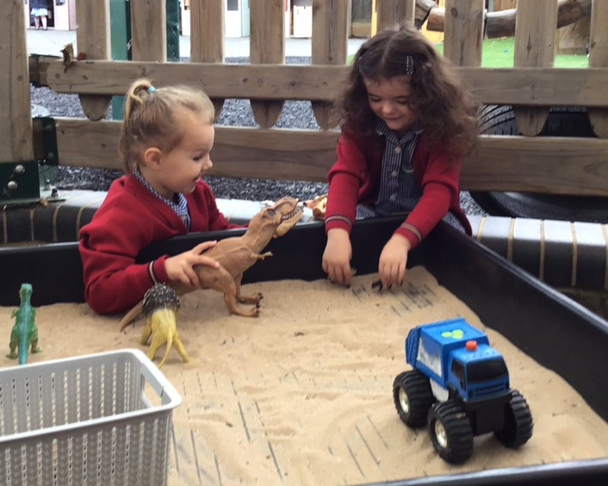
Bournes Green Schools
Believe, Grow, Succeed
Playing and Exploring
Realise that their actions have an effect on the world, so they want to keep repeating them
Plan and think ahead about how they will explore or play with objects
Guide their own thinking and actions by referring to visual aids or by talking to themselves while playing
Make independent choices
Bring their own interests and fascinations into early years settings - this helps them to develop their learning
Respond to new experiences

Slide 18
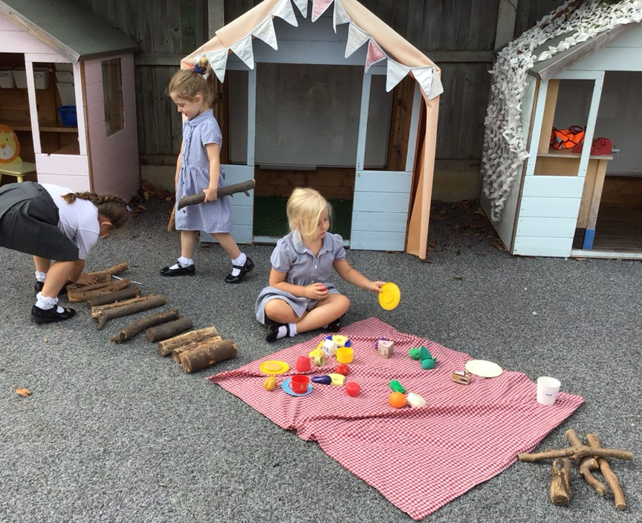
Bournes Green Schools
Believe, Grow, Succeed
Active Learning
Participate in routines.
Begin to predict sequences because they know routines, for example, they may anticipate lunch or get their coat when the door to the outdoor area opens.
Show goal-directed behaviour.
Begin to correct their mistakes themselves, for example, instead of using increasing force to push a puzzle piece into the slot, they try another piece to see if it will fit.
Keep on trying when things are difficult.

Slide 19
Bournes Green Schools
Believe, Grow, Succeed
Creating and Thinking Critically
Take part in simple pretend play.
Sort materials, for example, at tidy-up time, children know how to put different construction materials in separate baskets.
Use pretend play to think beyond the ‘here and now’ and to understand another perspective.
To know more and feel confident about thinking of their own ideas.
Make more links between those ideas.
Concentrate on achieving something that’s important to them - they are increasingly able to control their attention and ignore distractions.
Review their progress as they try to achieve a goal and check how well they are doing.
Solve real problems.

Slide 20
Bournes Green Schools
Believe, Grow, Succeed
Lunch
Bournes Green Infant School and Bournes Green Junior School - School Dinners & Packed Lunches (secat.co.uk)
All children in the Infant school are eligible for a free school dinner should you wish.
School dinners are ordered via through MCAS app.
If your child would rather a packed lunch, please pack enough food that they will eat. Please ensure you clearly label the lunchbox with your child’s name.
Please provide your child with a named water bottle.
We are an allergy aware school.
Please do not send any nut products into school via lunchboxes or donated items.

Slide 21
Bournes Green Schools
Believe, Grow, Succeed
Inclusion Team
Bournes Green Infant School and Bournes Green Junior School - Parent SEND Forum (secat.co.uk)
Mrs Goy (Inclusion Lead/SENCO)
Mrs Westlake (Learning Mentor)
Mrs De Santis (School Office and Wellbeing Assistant)
Please do get in touch if you need any support or advice. We want to help!

Slide 22
Bournes Green Schools
Believe, Grow, Succeed
Medicines in School
If you need medicines to be administered to your child in school, you must complete a form from the office. We will only accept medicines prescribed by a doctor, in their original packaging, are clearly named and the dosage requires them to be administered within the school day. The exception to this is if your child has a Care Plan.
If your child has asthma or requires a Care Plan for a medical condition, please contact Mrs Baker. In September, this will be Mrs Goy.

Slide 23
Bournes Green Schools
Believe, Grow, Succeed
Attendance & Punctuality
Bournes Green Infant School and Bournes Green Junior School - Attendance (secat.co.uk)
Holidays during term time are not authorised and you may incur a fine. We do not provide homework to take on holiday.
If you are struggling to get your child into school for any reason, please speak to us and we will do our best to support you.
Infant School times (these are slightly different for the first two weeks)
8-35am – Gates open (children may come into school from this time)
8-40am - Official start to the School Day
3-10pm - End of the School Day
If you are going to be late, please call the School Office.
If there is a different adult picking up your child at home-time, please contact the school office or e-mail the class teacher. Emails will not be read during teaching time.

Slide 24
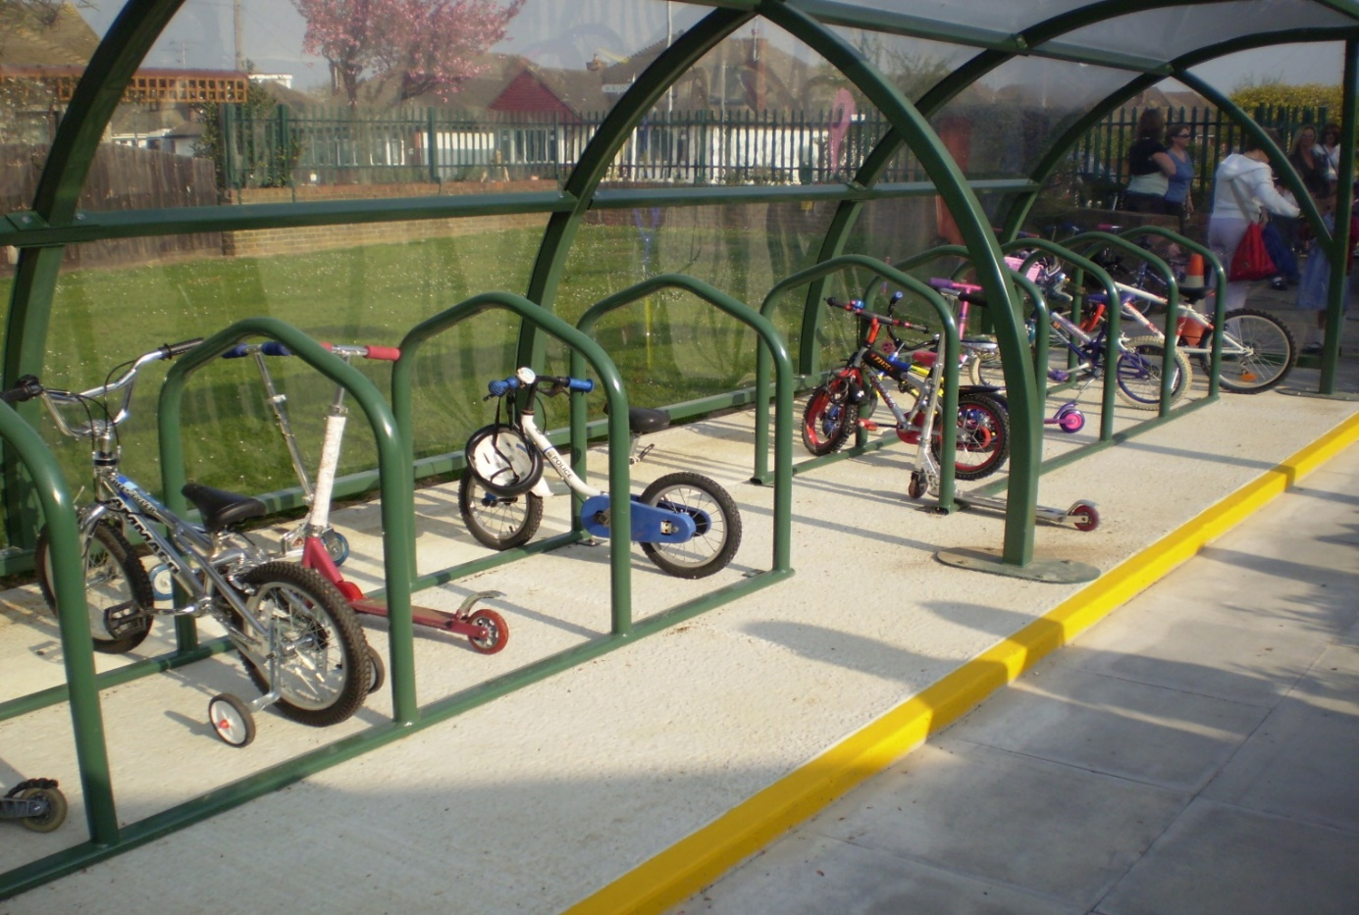
Bournes Green Schools
Believe, Grow, Succeed
Walk, Scoot or Cycle to School

Slide 25


Bournes Green Schools
Believe, Grow, Succeed
School Streets Scheme
Bournes Green Infant School and Bournes Green Junior School - School Streets (secat.co.uk)

Slide 26
Bournes Green Schools
Believe, Grow, Succeed
Parents Association
Bournes Green Infant School and Bournes Green Junior School - Parents Association (secat.co.uk)

Slide 27


Bournes Green Schools
Believe, Grow, Succeed
Communication
Class emails (e.g. RN@bournesgreen.secat.co.uk, RG@bournesgreen.secat.co.uk )
School Office (Mrs De Santis, Mrs Chiles-Paras)
Gate Duty
Parents Evenings
Open Evening in the Summer Term
Book Looks
Weekly Newsletter
Website
Social Media (Instagram)
Workshops/Stay and Play
My Child at School App (MCAS)
Tapestry
If you have any worries, concerns or
you are unhappy with something
we have done, please let us know!

Slide 28
Bournes Green Schools
Believe, Grow, Succeed
Questions?
Thank you for coming!

