Slide 1


Welcome to Bournes Green Infant School Nursery!

Slide 2
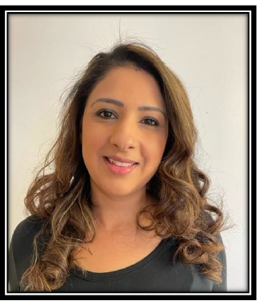
Mrs A Nagla
My name is Mrs. Nagla, and I am a qualified teacher with a BA (Hons) degree in Art.
I have been teaching for 23 years, working across Nursery, Reception, and Year 1. Throughout my career, I have taught in a variety of settings and communities, including Basildon, Wickford, Redbridge, Ilford, and now Southend.
Currently, I am proud to serve as the Early Years Lead and Senior Teacher, a role I have held for the past four years.
Early Years education has always been my passion. I find immense joy in working with young children, each of whom is wonderfully unique. It is truly exciting to see the creativity and curiosity they bring to the world!
On a personal note, I am a parent to two children, aged 11 and 14, so I understand the challenges and rewards of parenting firsthand.

Slide 3
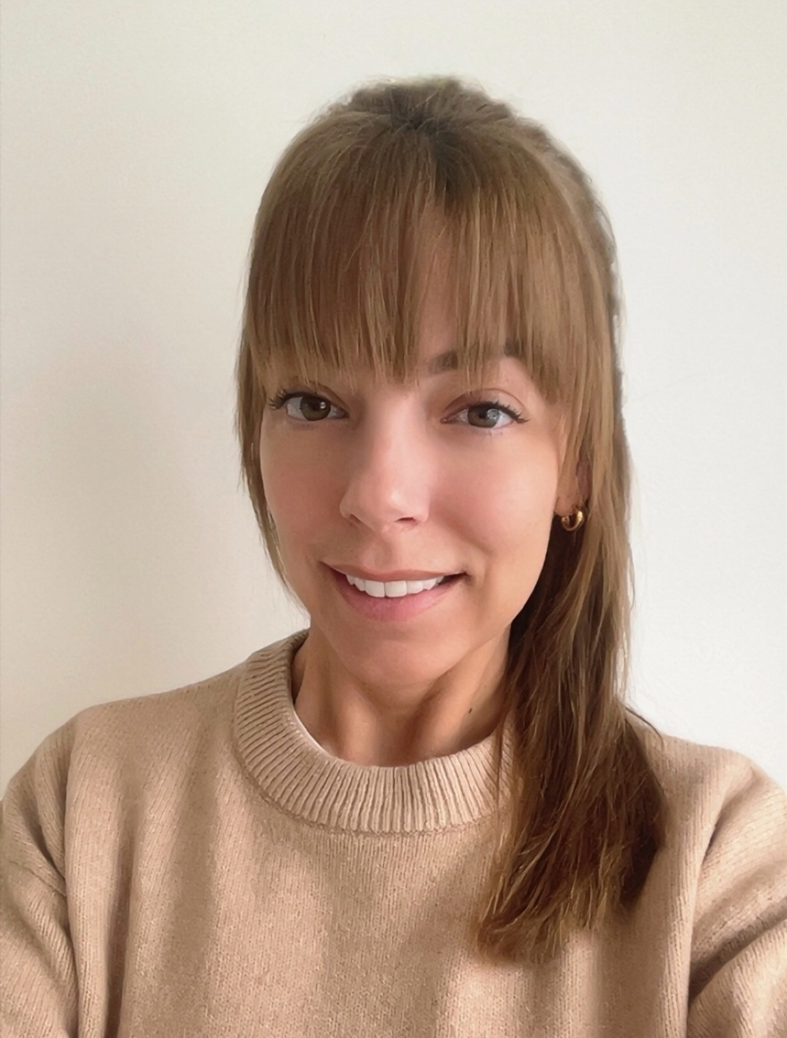
Miss L. Gower
I have been a Senior Nursery Practitioner for the past nine years running a very busy 2-3 year old room. I have worked in various Early Years settings including abroad as a children’s Representative.
I have Early Years Professional Status and a BA honours Degree in Early Childhood studies.
My interests include going to the gym and showing my two dogs at competitions around the country. I also enjoy spending time with family and friends.
I have a passion for Early Years and supporting children’s education.

Slide 4
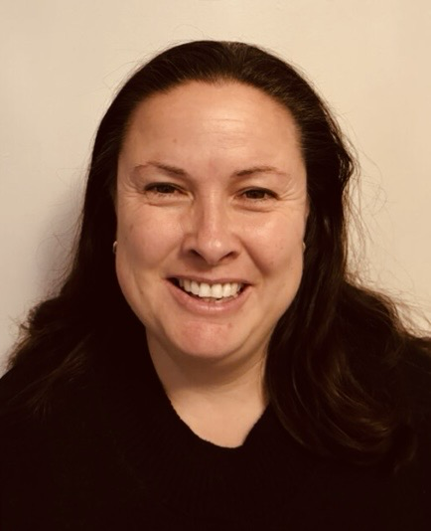
Mrs A. Miles
I have over 26 years of experience in childcare and education.
I am a proud parent of four children, two of whom attended BGS.
My professional experience includes:
Childminder for 4 years
Teaching Assistant across Year 1 to Year 6 for many years
Nursery Practitioner in two schools and a preschool setting
Working within a Special Educational Needs (SEN) department, supporting children from Reception to Year 6
I am passionate about supporting children’s learning and development, ensuring they feel valued and confident as they grow.

Slide 5
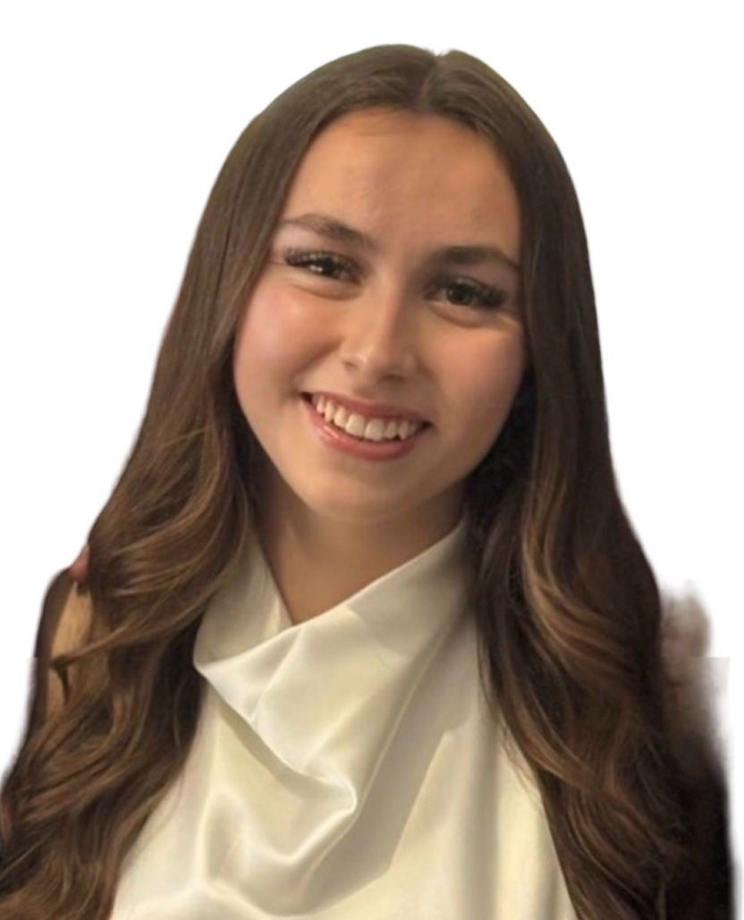
Miss O. Wells
I am currently completing my level 3 apprenticeship here at the school to be a qualified Early Years Educator. I previously taught gymnastics for 5 years working with children from the ages of 2-14years.
I enjoy working with children, watching them grow and develop into their own person.
Some of my interests include spending time with family and friends and I am also a keen traveller, exploring new countries and visiting new places.

Slide 6

Why choose us?
We are part of Southend East Community Academy Trust (SECAT)
Our academy is made up of five primary schools and one secondary school, all based in the Shoeburyness area.
SECAT has its own Board of Trustees, and each school has its own Local Governing Body (Academy Committee) which is accountable to the Trust Board.
Our Vision is to become recognised as an outstanding Educational partnership nationally.
Our Mission is to achieve outstanding outcomes for the young people in our community by providing an engaging and challenging learning experiences from 2 – 18 that equips them to live happy and success lives.
Bournes Green had 86% of children reach a Good Level of Development for the last two years. Substantially above National Average of 68%

Slide 7

Our Early Years Vision
At Bournes Green Infant School and Nursery, we focus on ensuring that young children are happy, confident, and well-rounded individuals who love to learn.
We believe that the Early Years Foundation Stage is vital for laying strong foundations that children will continue to build on throughout their school life.
Our aim is for children joining our early years classes to grow physically, verbally, cognitively, and emotionally, and to develop a positive attitude towards school and learning.
We achieve this by creating a safe and stimulating environment, indoors and outdoors, that meets each child's needs and interests. We are committed to valuing each child as an individual and helping them reach their full potential.

Slide 8

What is the Early Years Foundation Stage (EYFS) Curriculum:
At Bournes Green Infant School we follow the seven learning areas of the EYFS curriculum which are:
Communication & Language,
Physical Development,
Personal Social & Emotional Development,
Literacy and Mathematics,
Understanding the World and Expressive Art & Design,
This means your children are provided with the very best start to their education.

Slide 9

Online Learning Journal
At Bournes Green Infant School we use a secure online Learning Journal website called Tapestry to record your children’s learning through photos and observations. This provides a two-way communication tool between school and home. Nursery staff will add observations and photos of the children's learning over the week.
Parents will be sent a link through an email to enable them to register and sign up for their child’s online learning journal. We encourage you to sign up and engage with us to foster a healthy parent partnership.

Slide 10
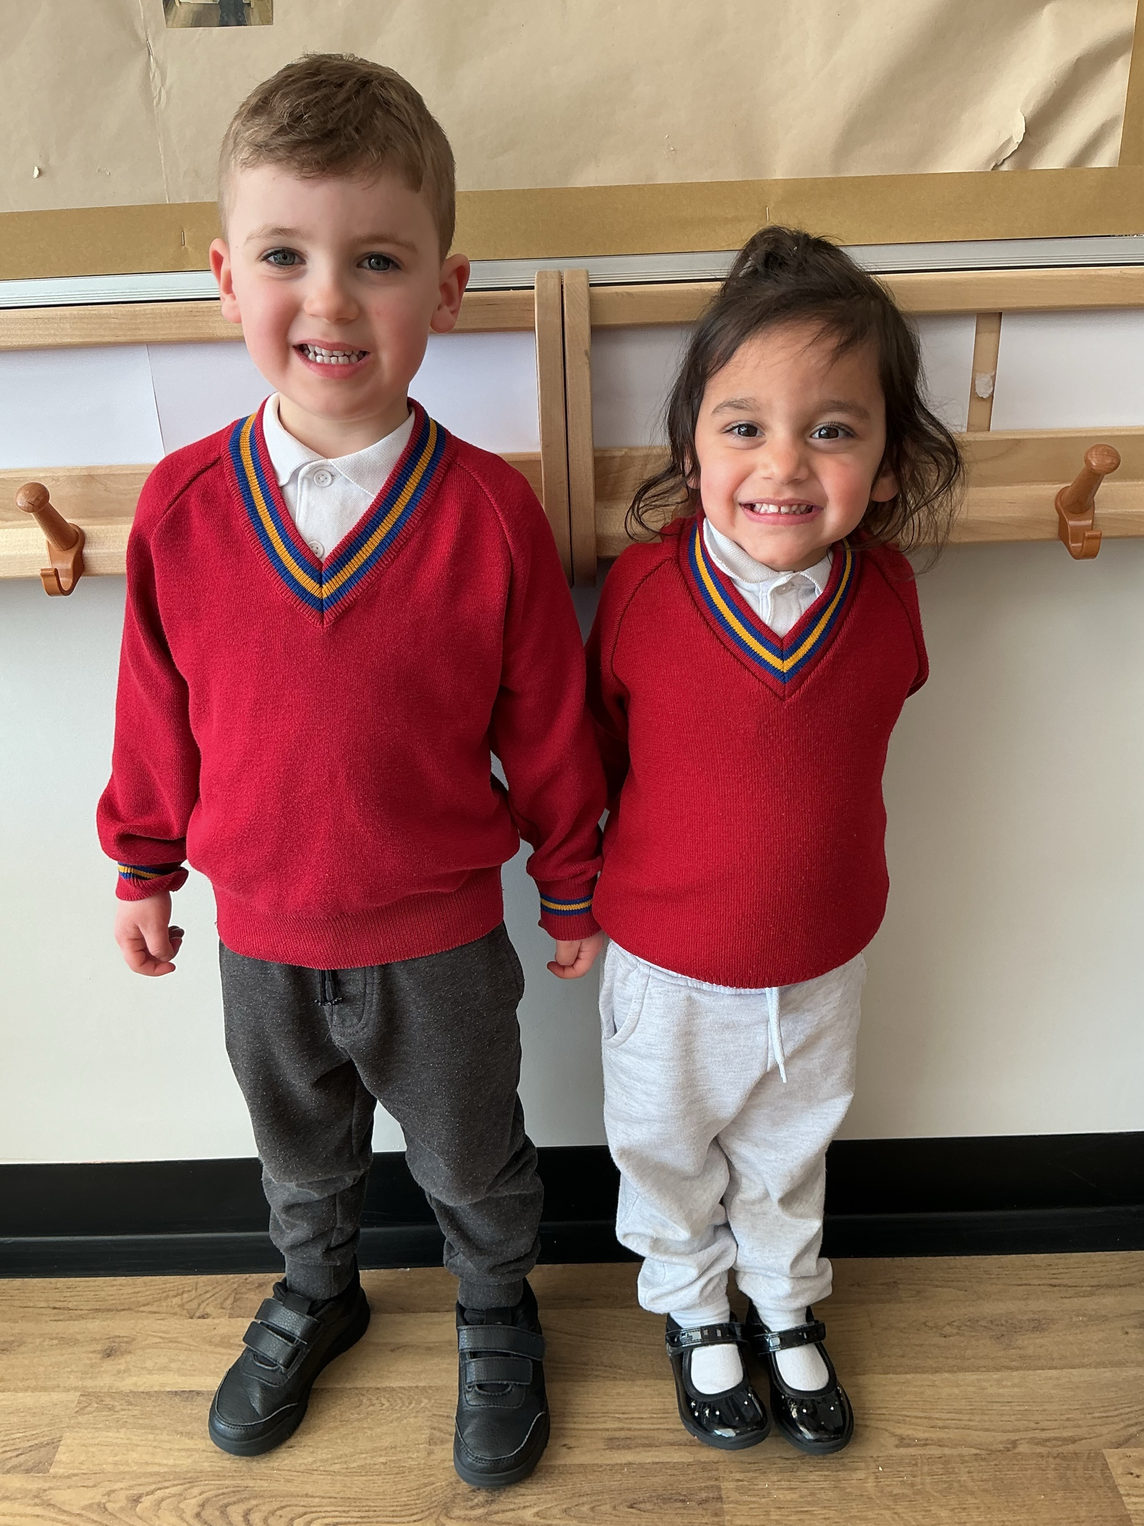
Uniform
Grey or black joggers/trousers/skirt
White polo shirt or shirt
Red school jumper or cardigan
Comfortable shoes

Slide 11

The Nursery Day
Our times and sessions are:
Morning Session
8.30am - 11.30am
Lunch
11.30am - 12.30pm
Afternoon Session
12.30pm - 3.30pm
What Does a Typical Day Look Like?
Your child’s day will be full of exciting opportunities to learn and play! We balance child-led activities, where children explore and follow their own interests, with adult-led sessions that help build key skills.
Our provision is mostly play-based, because we believe play is the best way for young children to learn and grow. Alongside this, children will also enjoy some short, structured sessions—such as Early Phonics—to support their language and reading development in a fun and engaging way.

Slide 12

One to One meetings and Transition
You will have the opportunity to meet the teachers in a one-to-one meeting with your child. This will support transition and help your child to become familiar with the new surroundings.
When your child begins Nursery, you will have the opportunity to come in with your child on their first day for a short time and then you will say goodbye.
We know this can be a difficult time for some children and we here to support them to settle.

Slide 13
Other staff
Mr Martinson- Headteacher
Mr Kent- Deputy Headteacher
Mrs Smith- Special Educational Needs and Disabilities Co-ordinator (SENDco)
If you have any concerns about your child, please speak to Mrs Nagla.

Slide 14
Nursery Fees
Time | 2025-26 Costs
1 hour | £8.00
Session (3 hours) | £24.00
Lunch session | £6.50
Paid hot meal | £3.00
We offer both 15 hour and 30 hour
Government, Early Years Entitlement
Funding.
Funding and Lunchtime
The 30-hour funding does not cover lunchtime. If you’d like your child to stay for lunch, this will be a paid session. You can either:
  Pay for the lunchtime session, or
  Collect your child and bring them home for lunch.
Payments
Lunchtime sessions are paid for in advance and invoiced half-termly.
All payments are made through My Child At School, and accounts should stay in credit.

Slide 15
Nursery Fees Contd.
Funding Codes
If you’re using government-funded childcare (15 or 30 hours), please make sure your eligibility code stays valid and is reconfirmed on time through HMRC.
If the code expires and funding stops, you’ll need to pay the full fees for any period without funding. We’ll invoice for this if it happens.
Extra Charges
Lunch Session
£6.50 per session.
Two options:
  Option 1: Bring a packed lunch from home (just the £6.50 session fee).
  Option 2: Request a hot school meal for an extra £3.00 (total £9.50).
Snacks
Fruit and milk are provided free during snack times.

Slide 16

How to Apply
Once our nursery is open for viewing, we warmly invite you to come and see our nursery classroom. Visiting gives you a chance to experience our setting and ask any questions you may have.
After your visit, you can collect an application pack from the school office and complete the nursery forms. When we receive your completed application, we will review it carefully.
Places are offered based on:
1. Looked after children
2. Parent/carer has a medical condition affecting mobility and this is nearest the family home or place of medical treatment
3. Children of staff members 4. Children with a sibling at the school 5. Nearness to the school - 'As The Crow Flies'
4. Children with a sibling at the school
5. Nearness to the school - 'As The Crow Flies'

Slide 17

Room Design and Furniture
Community Playthings
Why We Chose Community Playthings:
We have selected Community Playthings for our nursery furniture because they are recognised as industry leaders in early years environments.
Their products are crafted from solid wood, ensuring durability and a natural aesthetic that supports a calm, welcoming space for children.
Importantly, no harmful chemicals are used in their manufacturing process, making them safe for young learners.
Each item comes with a 15-year warranty, reflecting the company’s commitment to quality and longevity.
Above all, Community Playthings furniture is designed to be safe, secure, and developmentally appropriate, giving parents peace of mind and children the best possible start.

Slide 18
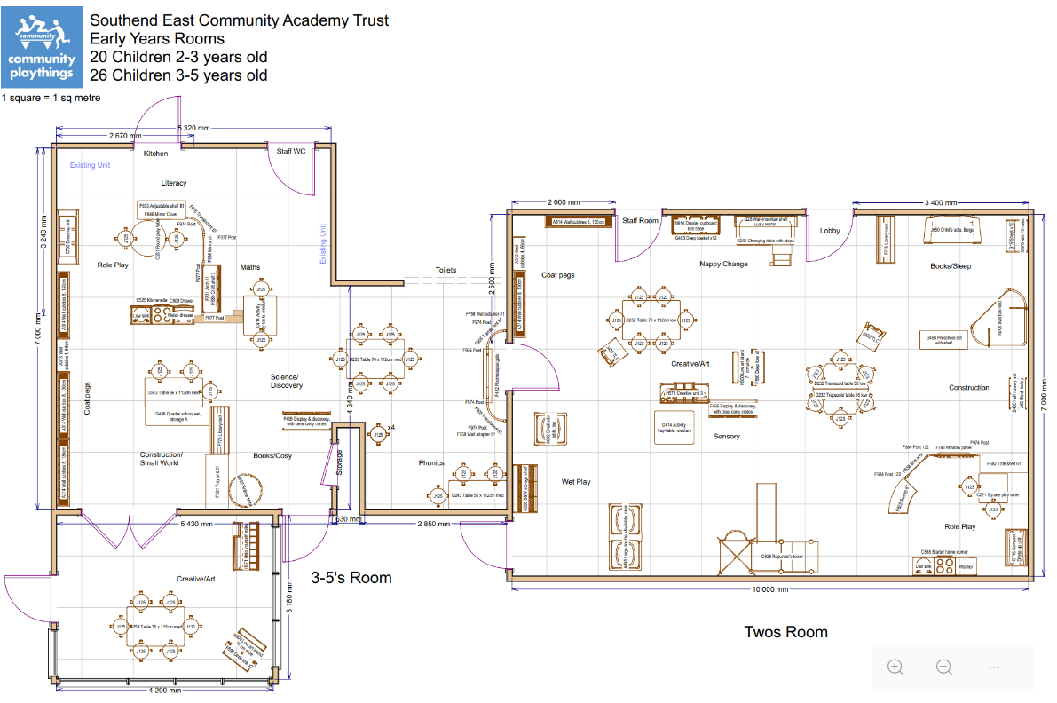

Slide 19
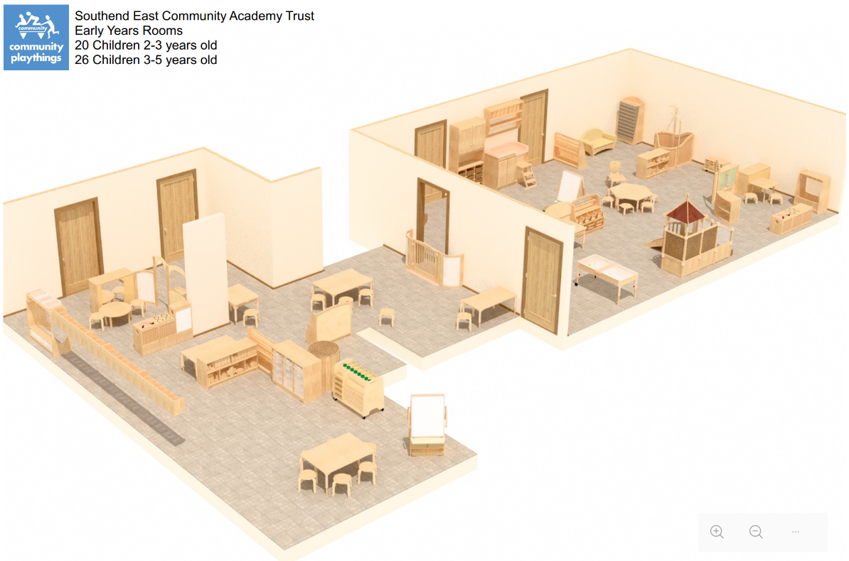

Slide 20
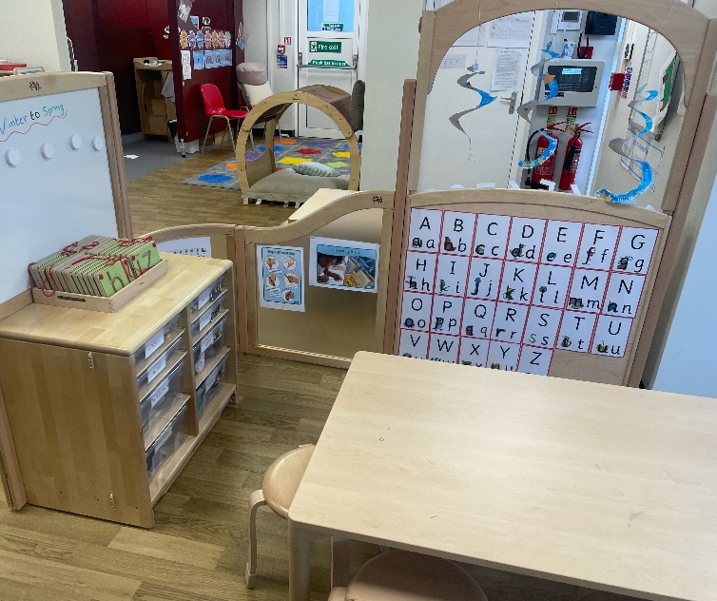
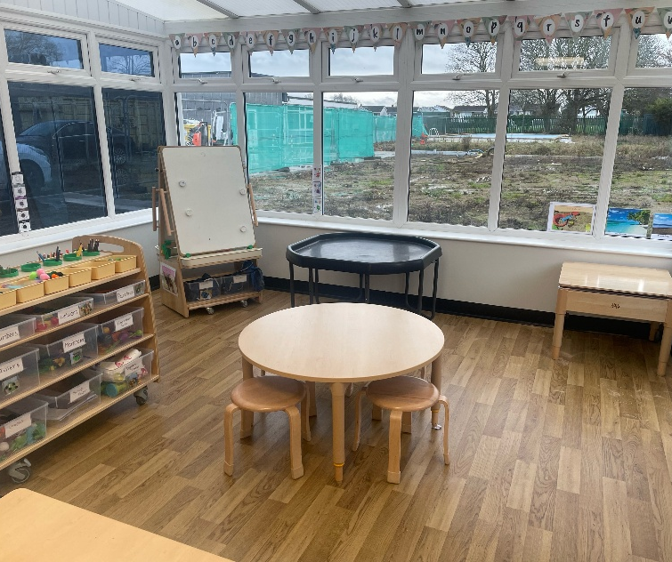
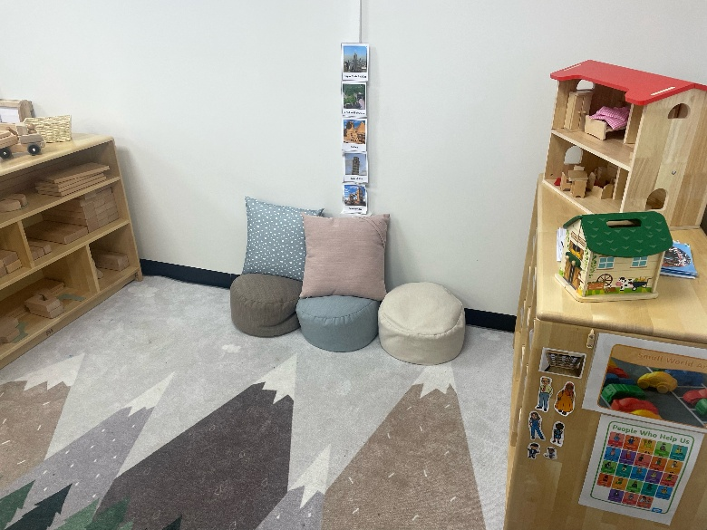
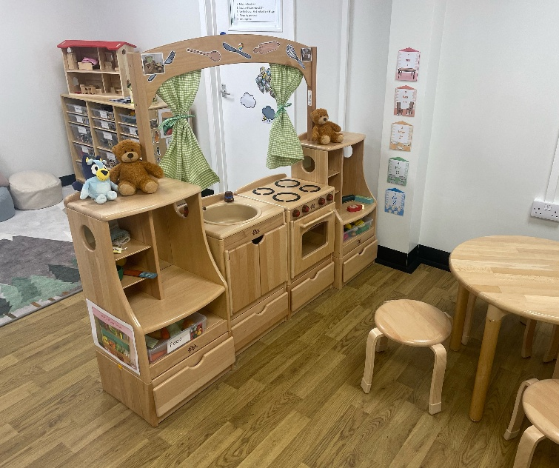
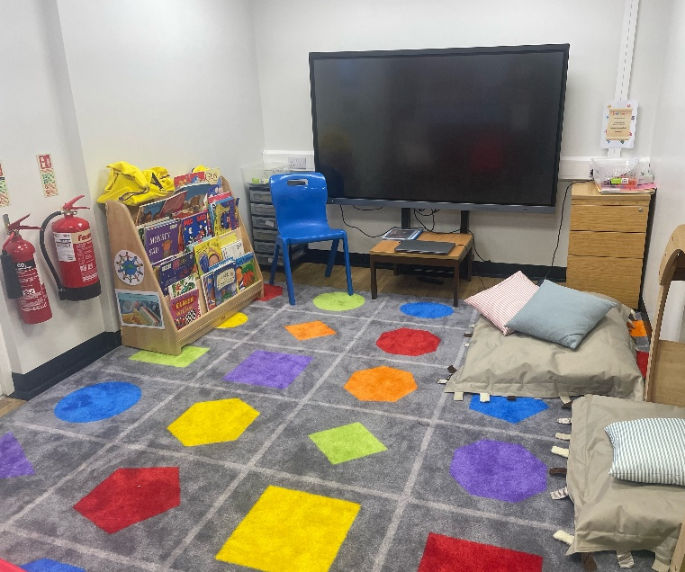
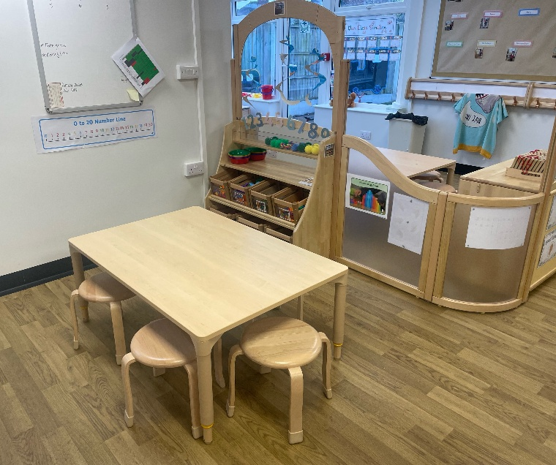

Slide 21
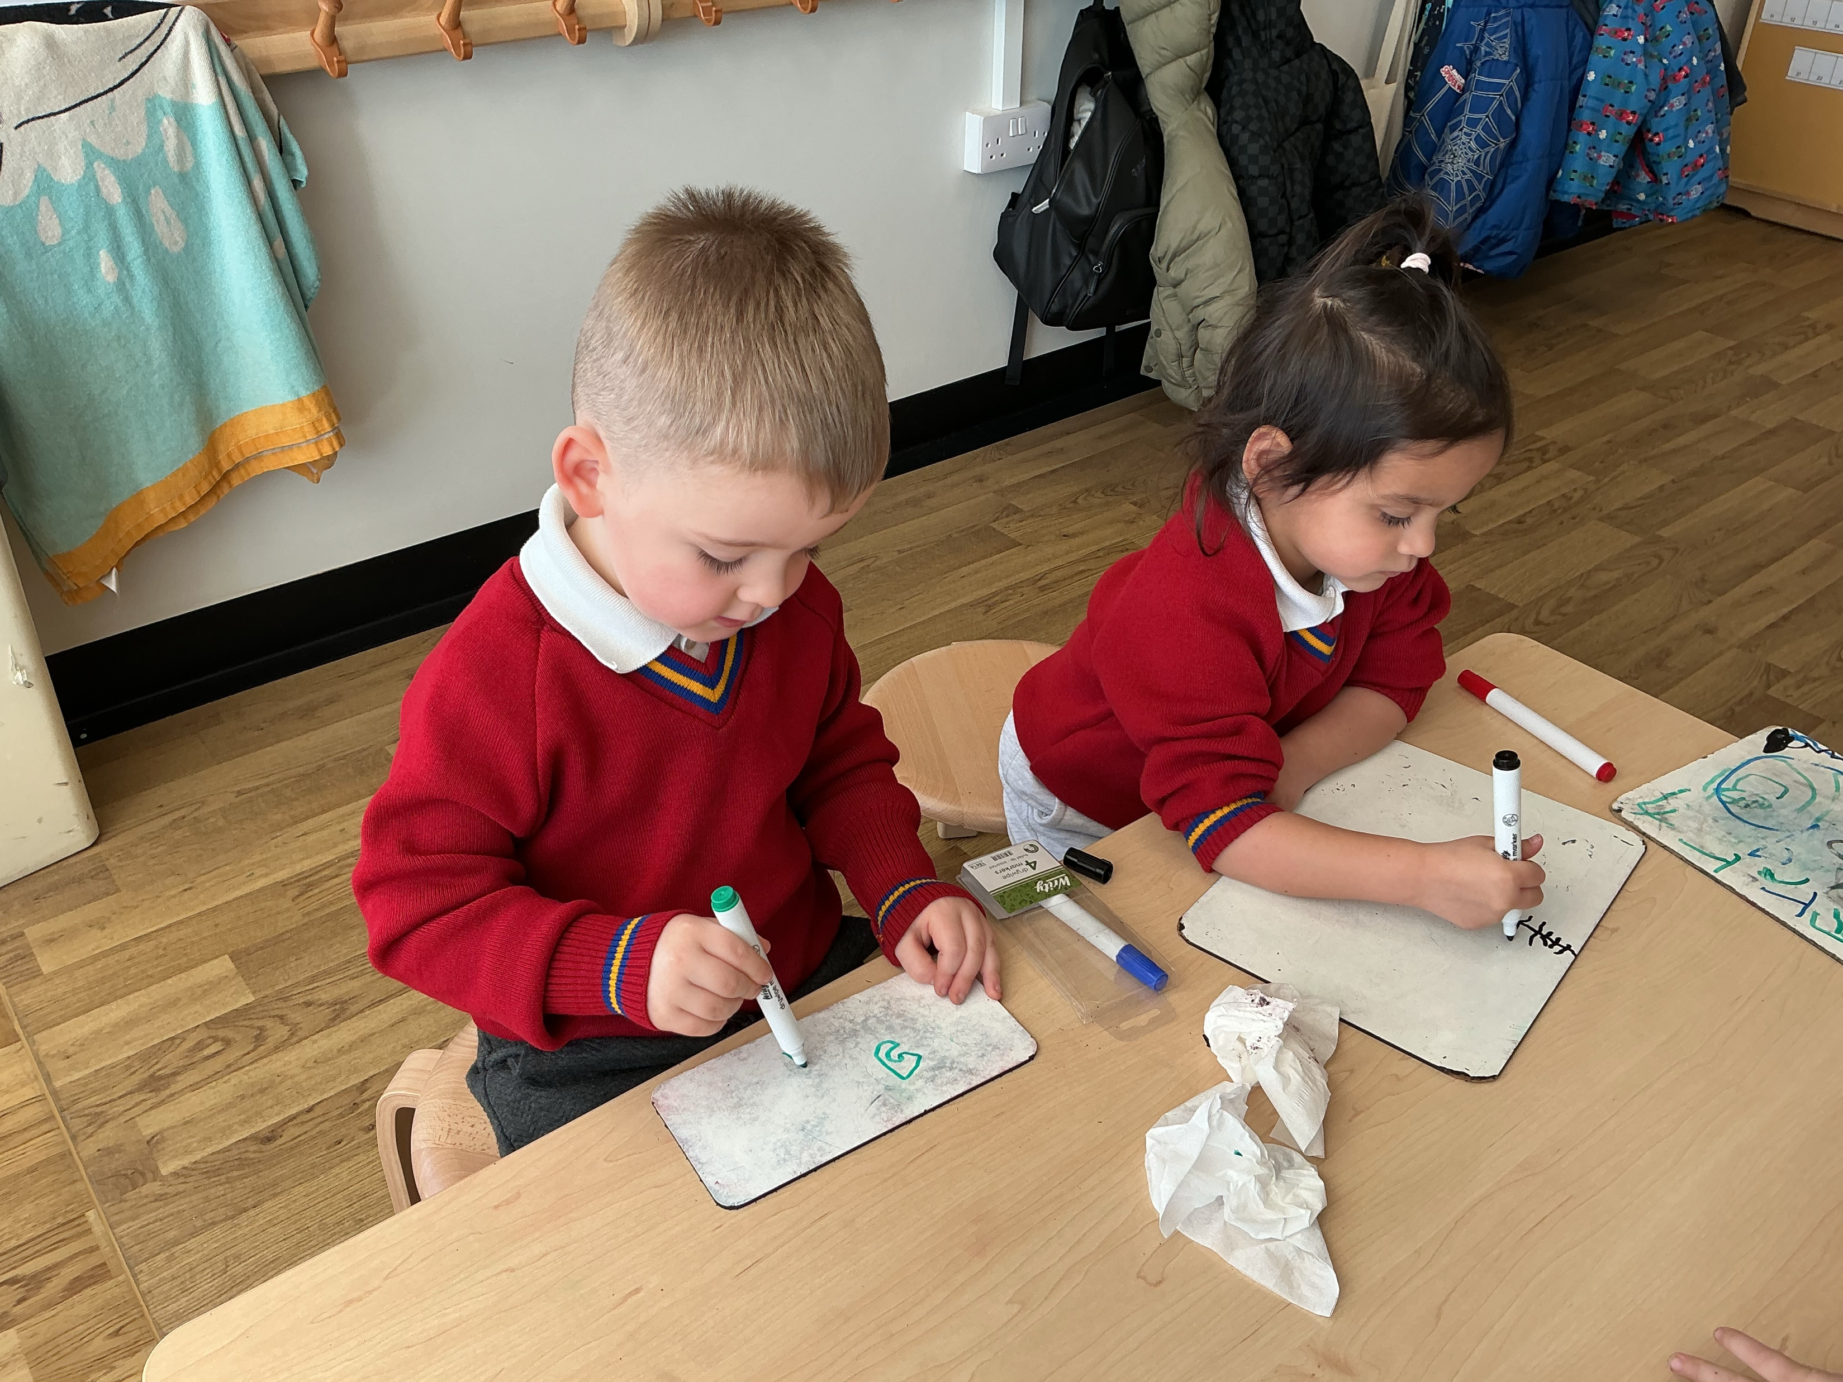
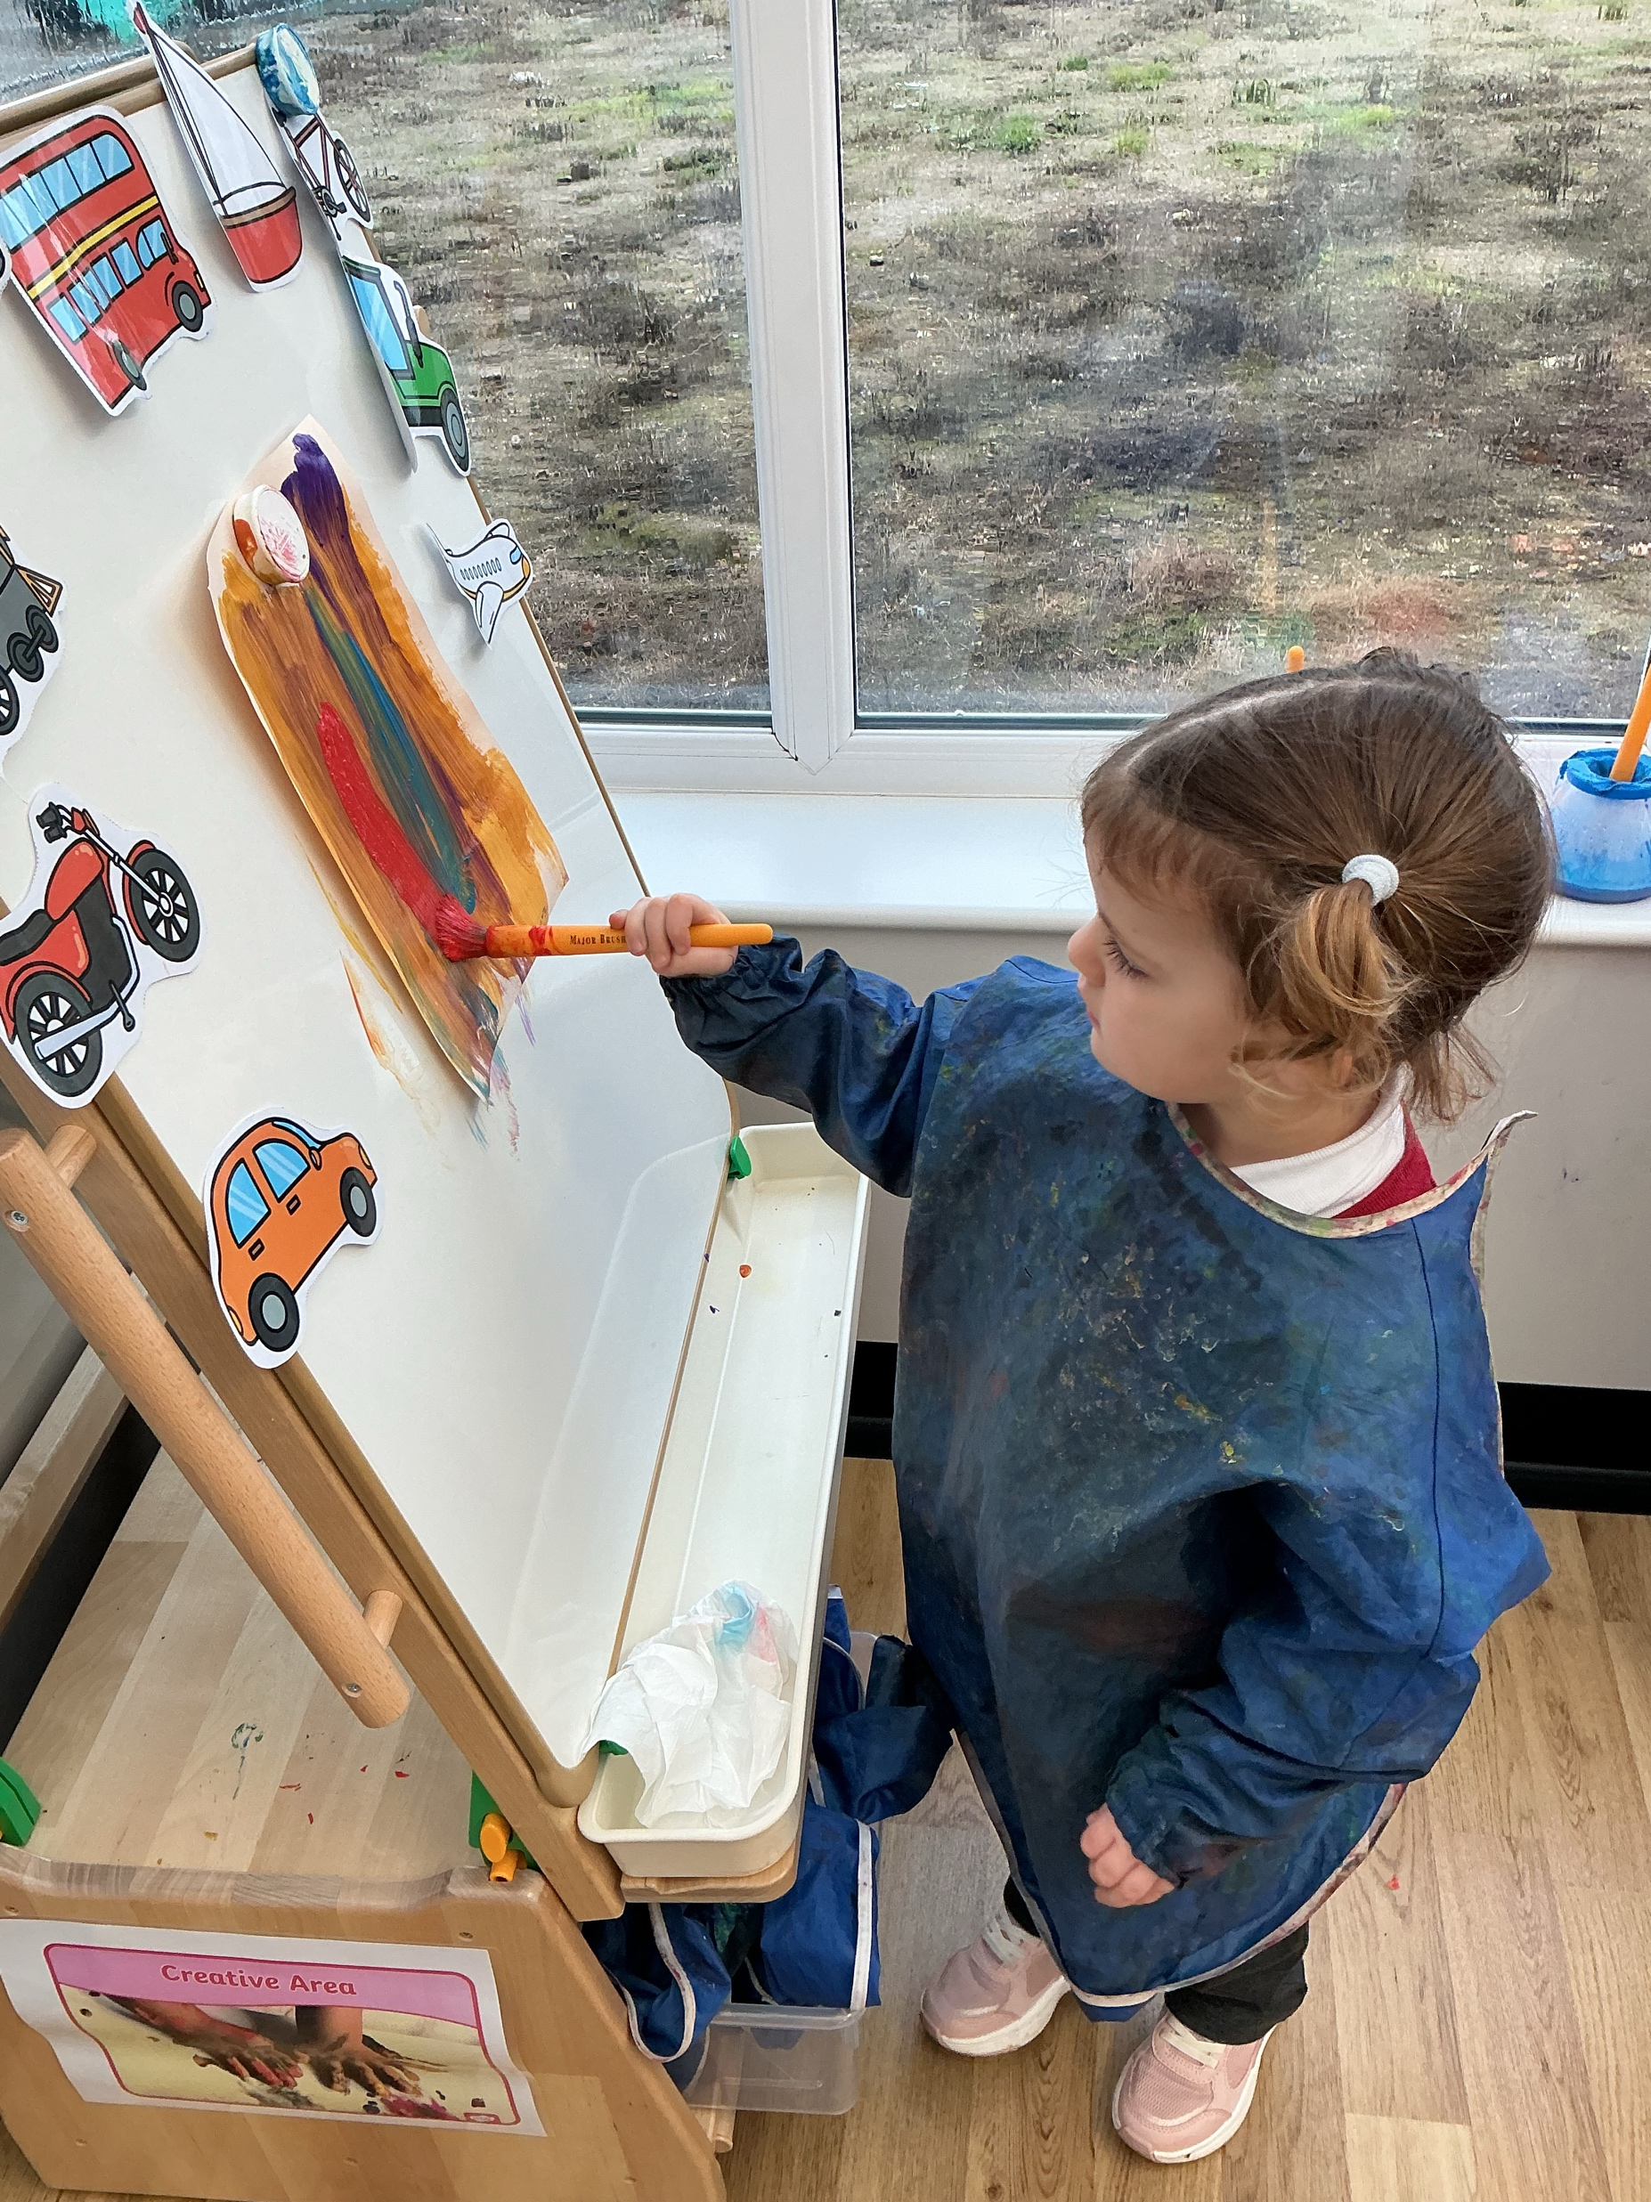
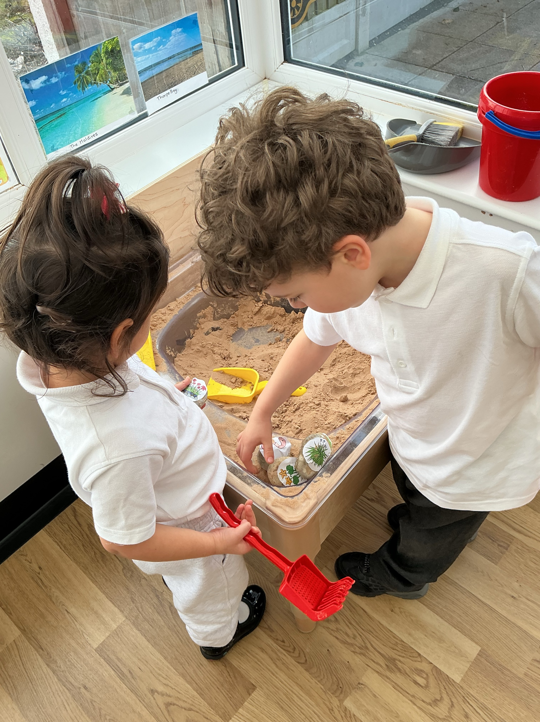
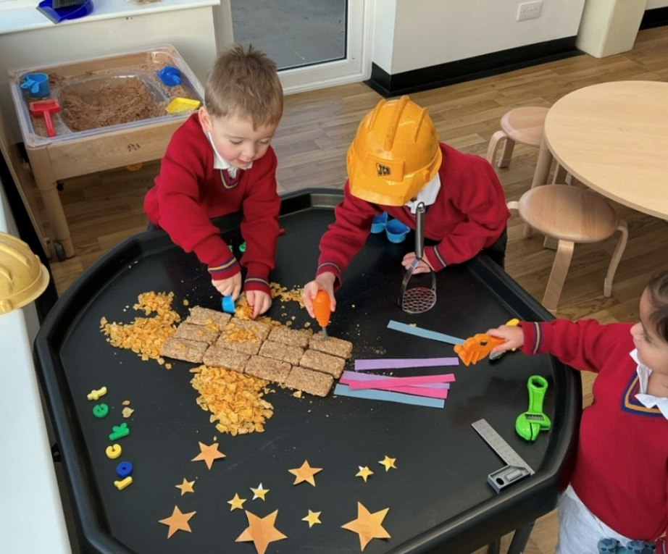
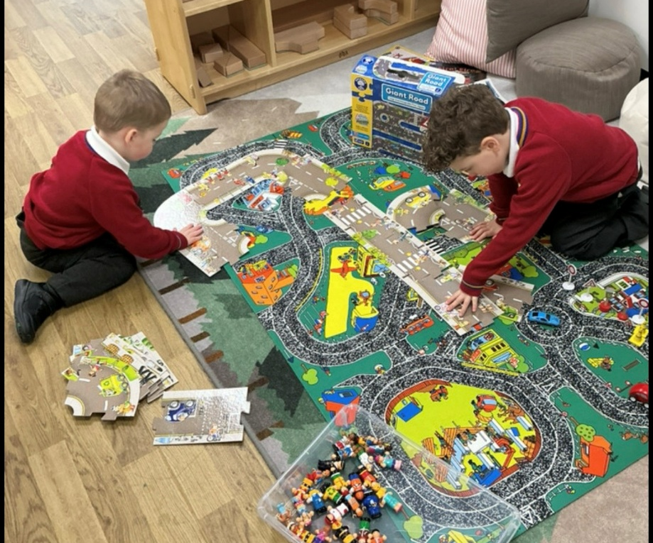

Slide 22

Thank you for listening!
Any questions?

